Slide 1
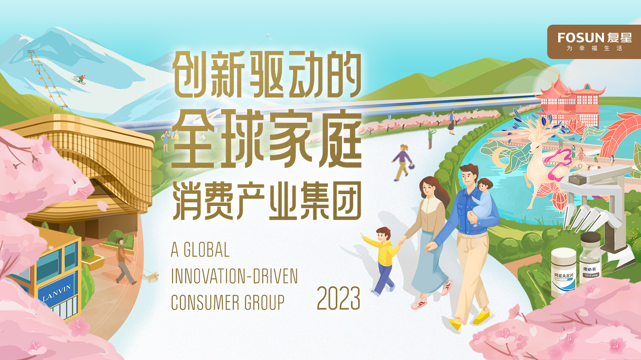

Slide 2

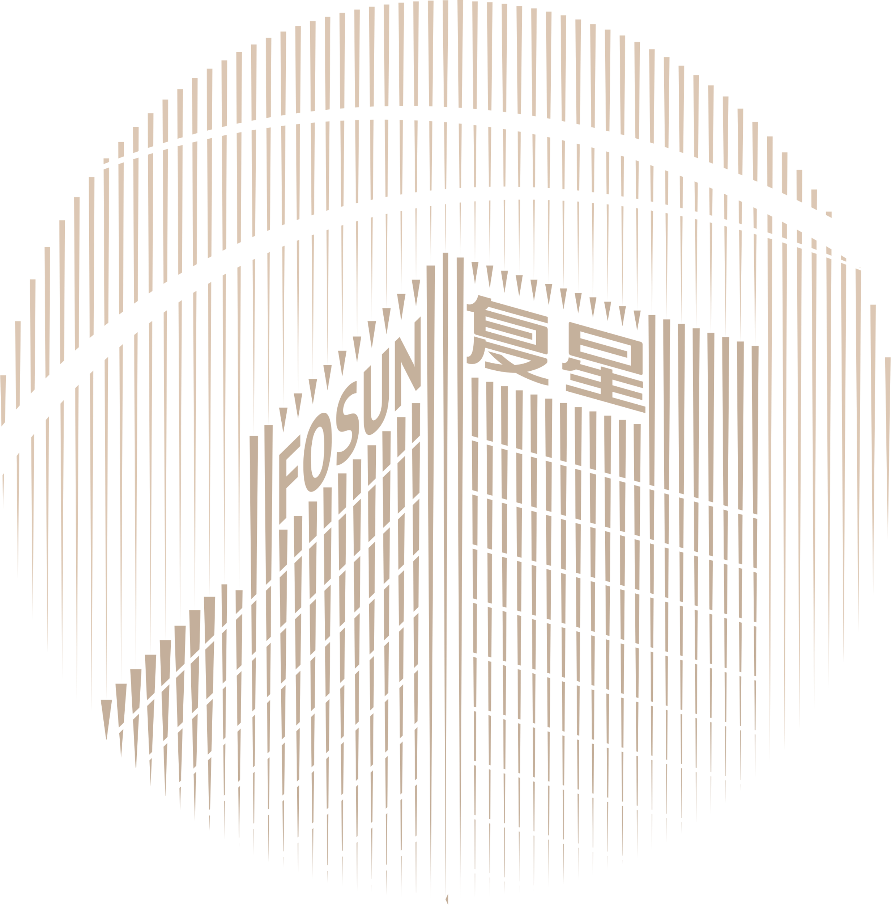





FOSUN, TOWARDS A BRIGHTER LIFE
MISSION
Creating happier lives for families worldwide
VISION
Rooted in China, Fosun is committed to creating a global happiness ecosystem fulfilling the needs of one billion families in Health, Happiness, and Wealth
VALUE
Self-improvement, Teamwork, Performance, and Contribution to Society

Slide 3


A GLOBAL INNOVATION-DRIVEN CONSUMER GROUP
Fosun was founded in 1992. Our mission is to provide high-quality products and services for families around the world in Health, Happiness, Wealth and Intelligent Manufacturing segments.
Total Revenue
Total Assets
Number of Employees
Forbes Global Ranking 2022
ESG Rating
Global Operations
R&D Investment
Number of C-end Customers
175.39
823.1
billion
108,000
No. 589
AA
35+
countries and regions
10.4
billion
464
million
*
(2022)
MSCI
A
billion
with revenue exceeding RMB100 million
10-year compound growth 13%
HSI
1771
Cumulative number of operational members¹
Patents for inventions
10+
Global technology innovation centers
* Currency in RMB and data as of 31 December 2022 unless otherwise specified
¹ Operational members: customers who have agreed to the official membership terms of the brand and granted privacy in any channel, and actively retained personal information including mobile phone numbers, to meet the needs of identifiable, reachable and traceable consumers are defined as registered members (i.e. operational members). From 2022 onwards, this statistic includes consumers in the Fosun Health ecosystem

Slide 4



ROOTED IN CHINA, DEVELOPING GLOBALLY
Over the past 30 years, Fosun has implemented the twin-driver strategy of “Profound Industry Operations + Industrial Investment" to strengthen its foothold in various industries. Through continuous innovation, Fosun has achieved rapid development by capitalizing on the opportunities and momentum of China and the world's economic development
2022
Lanvin Group was listed on NYSE
Yelanggujiu
2020
DJULA
WEI Beauty
Jinhui Liquor
Shede Spirits
2018
LANVIN
Wolford
Lovelink (formerly known as Baihe Jiayuan)
Songhelou
Fosun Tourism Group was
listed on HKEX
2010
Club Med
Shanghai Henlius
2012
Pramerica Fosun Life Insurance
Peak Reinsurance
Starcastle Senior Living
2016
Gland Pharma
HAL
Wolverhampton Wanderers F.C.
Babytree
AHAVA
2003
Nanjing Iron & Steel
Sinopharm Group
2014
Fidelidade
Luz Saúde
Roc Oil
1998
Fosun Pharma was listed on China’s A-share market
1992
Fosun was founded with a capital of RMB38,000
2002
Yuyuan
2007
Hainan Mining
Fosun International was (00656.HK) listed on HKEX
1994
Fosun Pharma
Forte
2011
BFC
2013
Atlantis Sanya
Foshan Fosun Chancheng Hospital
Sisram Med
2021
Sergio Rossi
Bankhaus Lampe
Wansheng Co.
2015
Privatization of Club Med
Thomas Cook
Silver Cross
2019
FFT
Shanghai Henlius was listed on HKEX
2017
Fosun United Health Insurance
Dongjia APP

Slide 5






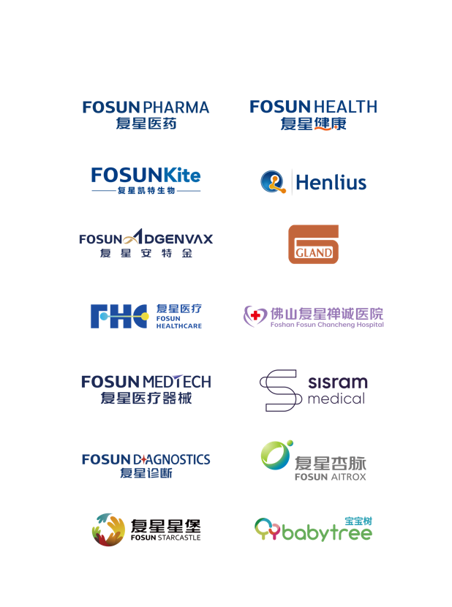

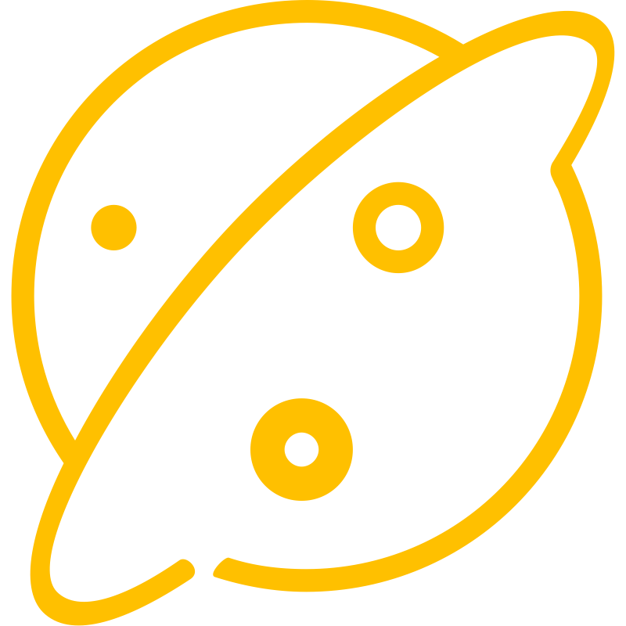


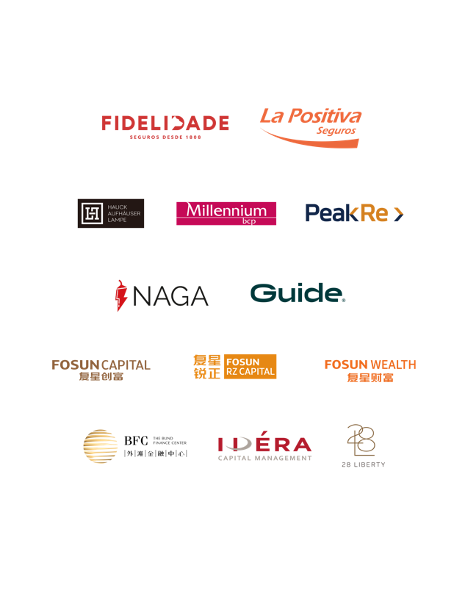
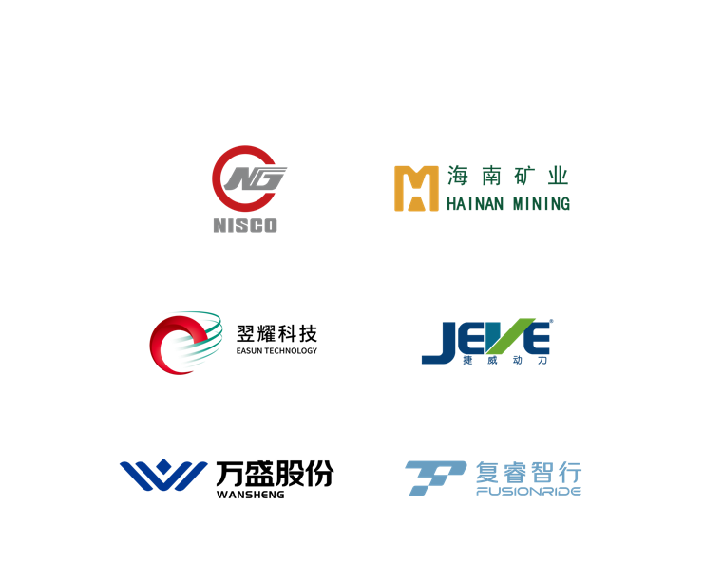
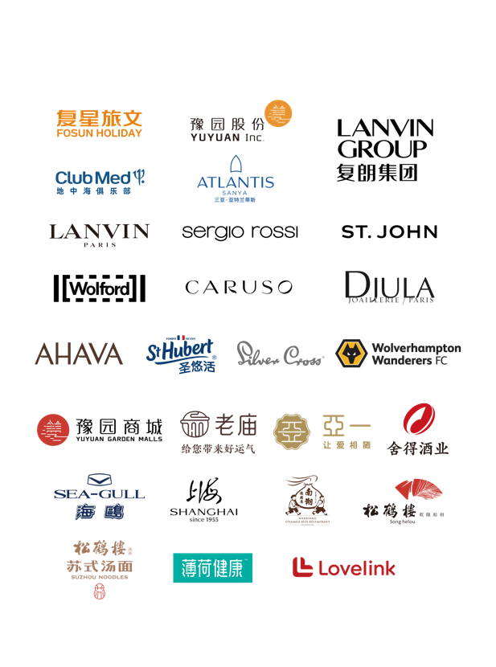
FOSUN FAMILY HOUSEHOLD CONSUMPTION ECOSYSTEM
EVERY STAGE OF LIFE
HEALTH
HAPPINESS
WEALTH
INTELLIGENT MANUFACTURING

Slide 6
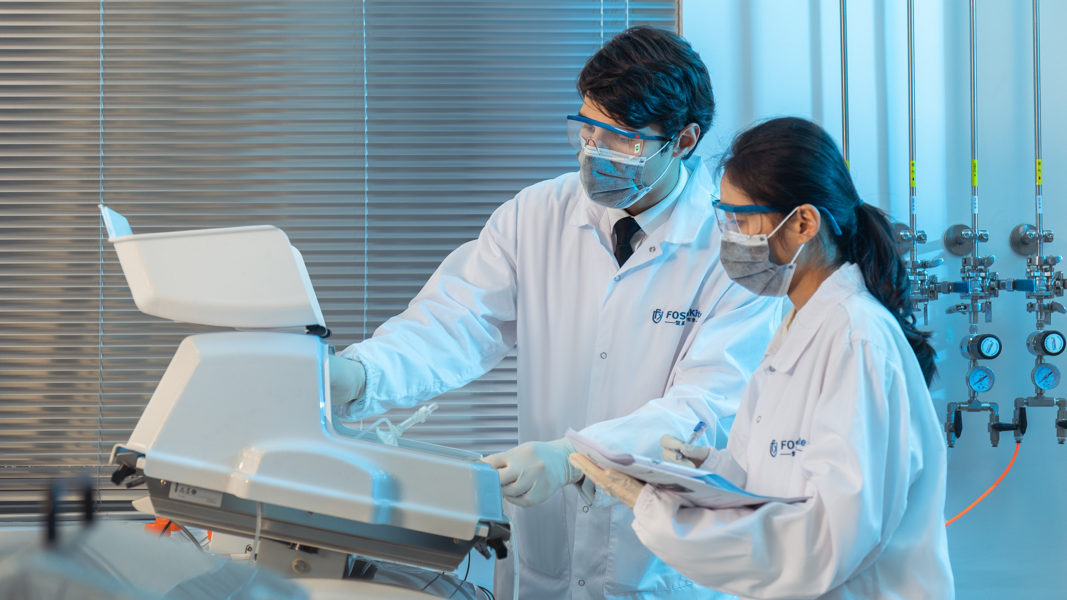


HEALTH
Transform the industry with technology
to create healthier lives

Slide 7

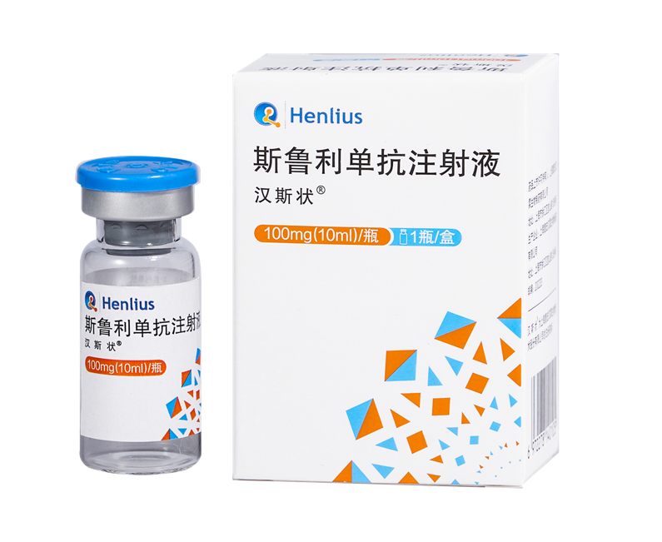





PHARMACEUTICALS
Fosun Pharma continues to increase investment in innovation and R&D to promote innovative transformation, and focuses on the three major business divisions of innovative medicines business, established medicines manufacturing and supply business and vaccines business.
Over 30%
Revenue contribution of new and sub-new products
RMB5.89 billion
Fosun Pharma’s R&D investment in 2022
Over 260
Pipeline projects on innovation drugs, biosimilars, generic drugs, and consistency evaluation items
249
Patents applied in the pharmaceuticals segment
The world's first PD-1 inhibitor approved for the first-line treatment of small cell lung cancer (SCLC)
Han Si Zhuang 汉斯状®
Approved for three indications in China: MSI-H, sqNSCLC and ES-SCLC; SCLC indication was granted Orphan Drug Designation by the U.S. FDA and the European Commission (EC), the marketing authorization application (MAA) for the treatment of ES-SCLC in Europe was accepted by the European Medicines Agency (EMA)
China’s first approved CAR-T cell therapy
Yi Kai Da 奕凯达® (ejilunsai injection)
As of the end of January 2023, it had benefited more than 300 patients with relapsed or refractory large B-cell lymphoma; the indication for second-line treatment was accepted in October 2022 and has been included in the list of priority review products
More than 31 million doses of Comirnaty (mRNA COVID-19 vaccine)
Had been administered in Hong Kong SAR, Macau SAR and Taiwan region since its launch to end of February 2023
Azvudine tablets
Fully commercialized in China and included in the National Medical Insurance Drug Catalogue 2022;
6.74 million bottles delivered as of the end of 2022

Slide 8
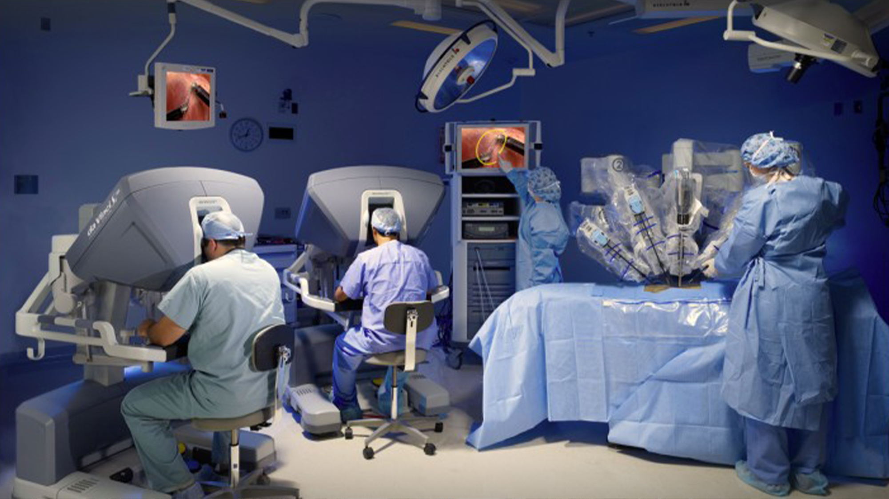




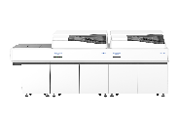
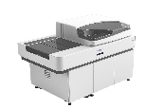

MEDICAL DEVICES & DIAGNOSTICS
More than 300
da Vinci Surgical Systems installed in Chinese mainland, Hong Kong SAR and Macau SAR as of 31 December 2022
More than 10 million
Surgeries operated by the da Vinci Surgical System
Over 700 million investment
Intuitive Fosun's Medical Robot Manufacturing and R&D Center started construction in Shanghai
Launched 3 new products on the medical beauty platform
1) Alma Ted™, an Ultrasound-based treatment for hair loss
2) CBD+Professional Skincare Solution™
3) LMNT one™, a home-use beauty device
The proportion of direct sales revenue on the medical beauty platform increased to 66%
Strengthened its global operational capabilities and added direct sales team in the U.K. and Dubai
Comprehensively promoted the operation integration of the diagnostic sector and established six major R&D & production bases. The business mainly includes immunodiagnosis, biochemical diagnosis, microbial diagnosis, molecular diagnosis, and Point-Of-Care Testing (POCT)
In June 2022, the F-C800p fully automated biochemical analyzer was approved for registration. After being connected with F-i3000, Fosun Diagnostics' FCi biochemical and immunological pipeline was formed to fully meet the testing needs of clinical departments

Slide 9
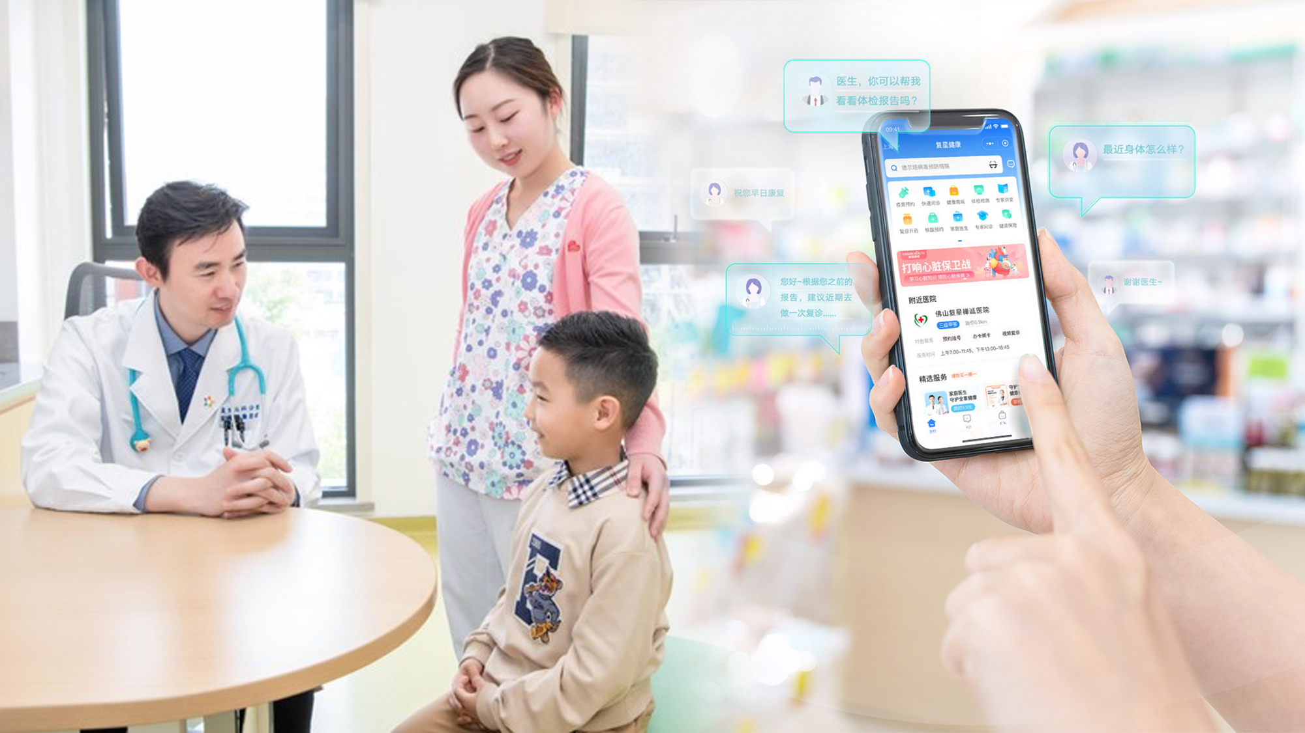




HEALTHCARE SERVICES
Accelerate online and offline integration and service network construction, and build a one-stop active health management model (FHMO) that integrates medicine and healthcare throughout the treatment course
10 Internet hospital licenses
Has been integrating offline medical institutions and Internet medical platforms, and establishing online medical and healthcare services since 2021
Ranked 1st among China’s non-public hospitals in terms of competitiveness for 5 consecutive years
Foshan Fosun Chancheng Hospital passed the Joint Commission International (JCI) accreditation with high score
6,333 beds ¹
In member hospitals
12 major specialty alliances
Emphasizes the construction of disciplines with the establishment of specialty alliances including obstetrics and gynecology, cardiology, orthopedics. The team of leading experts in various specialties including urology, orthopedics, nephrology, and rehabilitation have made significant progress
¹ It refers to the number of beds in member hospitals as of the end of 2022

Slide 10


HAPPINESS
Develop contents, models and products for families
to link online platforms and offline scenarios

Slide 11
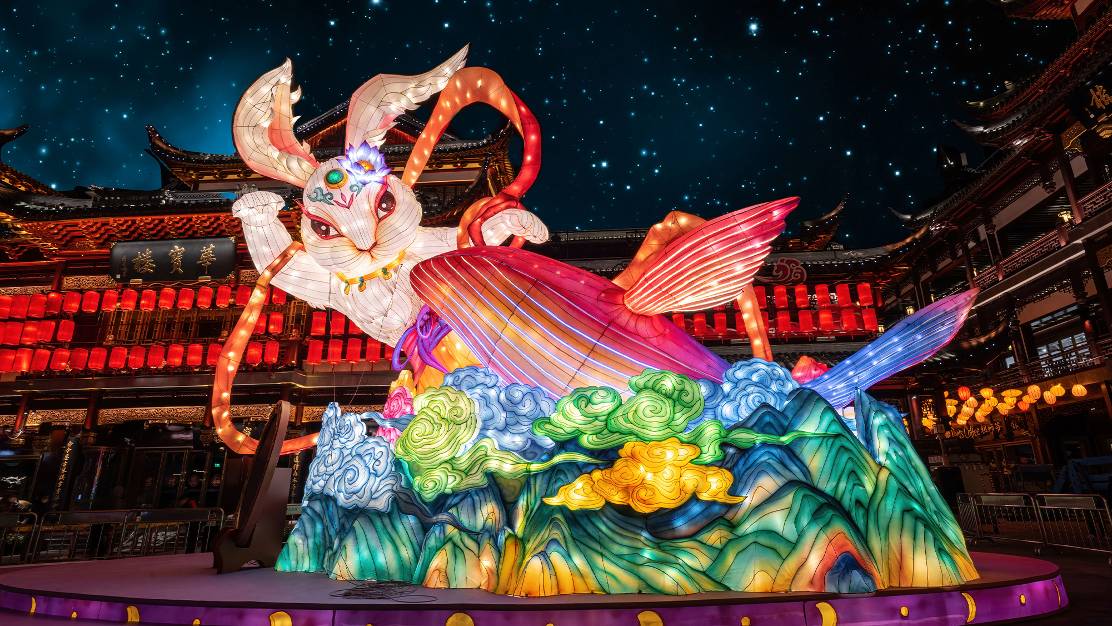

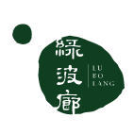
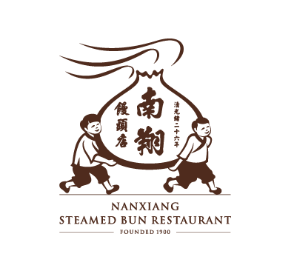
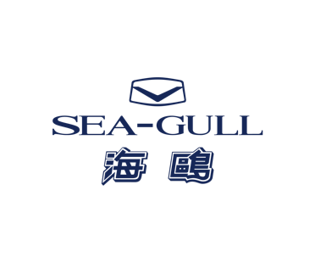
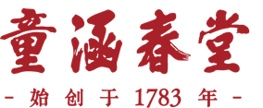
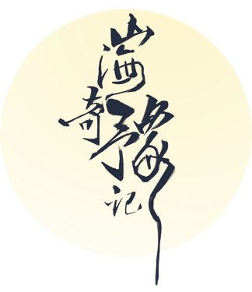


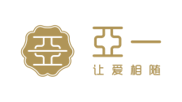
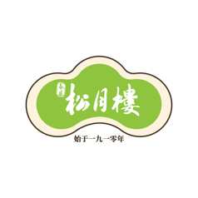


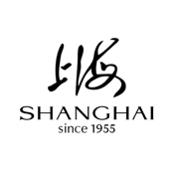
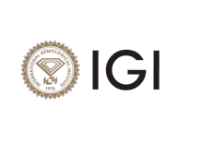


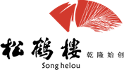
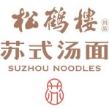

YUYUAN
As one of the flagship platforms of Fosun‘s Happiness segment, Yuyuan takes oriental aesthetics as the key strategy to promote Chinese culture to the world,
creating happier lives for families worldwide
YUYUAN GARDEN
LANTERN FESTIVAL
JEWELRY AND FASHION
FOOD AND BEVERAGE
SPIRITS AND LIQUOR
CHINESE WATCHES
BEAUTY AND HEALTH
· Inspired by Shanhaijing, also known as "the Classic of Mountains and Seas", the lantern festival attracted more than 4 million visitors
· Recommended by national media platforms and agencies stationed abroad
· 4,592 points of sale
· Lab-grown diamond brand LUSANT opened its first offline store
· Accelerated chain development of catering brands
· Songhelou Suzhou-style noodle shop has 167 shops in 16 cities across the country
· Shede Spirits adheres to the "aged spirits strategy", the “multi-brand matrix strategy”, the “brand rejuvenation strategy” and the “internationalization strategy”
· Exported to 25 countries and regions
Two Chinese watchmakers ,
and the Chinese chip
· Time-honored brands with more than 200 years of heritage
· Bring brands to the global stage to reshape their future

Slide 12



FOSUN TOURISM GROUP
As a flagship platform of the Happiness segment, Fosun Tourism Group (FTG) is the world’s largest leisure tourism resorts group, and is striving to create a new concept of “Better Holiday, Better Life”, infusing evolving concepts of tourism and leisure into everyday living
A world-renowned premium all-inclusive vacation service provider from France
A one-stop ocean-themed integrated resort destination
Operating nearly 70 resorts on six continents around the world
Plan to open 17 new resorts from 2023 to 2025
In 2022, Club Med recorded a business volume of RMB12.011 billion, an increase of 108% compared to 2021
A benchmark of Sanya Tourism 3.0
In the first two months of 2023, Atlantis Sanya's business volume fully recovered and exceeded pre-pandemic levels, with an average room occupancy rate of 96%

Slide 13







LANVIN GROUP
A grand transformation. Lanvin Group has entered the new phase of global development
On 15 December 2022, Lanvin Group was listed on the New York Stock Exchange (NYSE) under the ticker symbol "LANV", becoming China's first global luxury goods group listed on the NYSE
The oldest operating French couture house
LANVIN
Italian luxury shoemaker Sergio Rossi
Austrian luxury skin wear brand Wolford
American luxury
womenswear brand
St. John
Italian high-end menswear brand
Caruso
Covering 80+
Approx. 1200
Approx. 300
countries and regions
points of sale
self-operated retail stores

Slide 14




MORE HAPPINESS
Focusing on sports, e-sports, film and television, games and other content to create a diversified entertainment experience of Fosun
E-sports teams under Fosun Sports have accumulatively won
7 championships and 3 runners-up
in various competitions throughout the year, setting a record high
One of the founding members of the English Football League
Fosun's Sports' Wolverhampton Wanderers F.C. in the Premier League has won 11 league titles, 4 FA Cups and 2 League Cups
Lovelink strengthened its wedding planning business in 1st and 2nd-tier cities
The love community has expanded its overseas presence, and Beloved, an online interactive product for couples, has been launched in North America

Slide 15
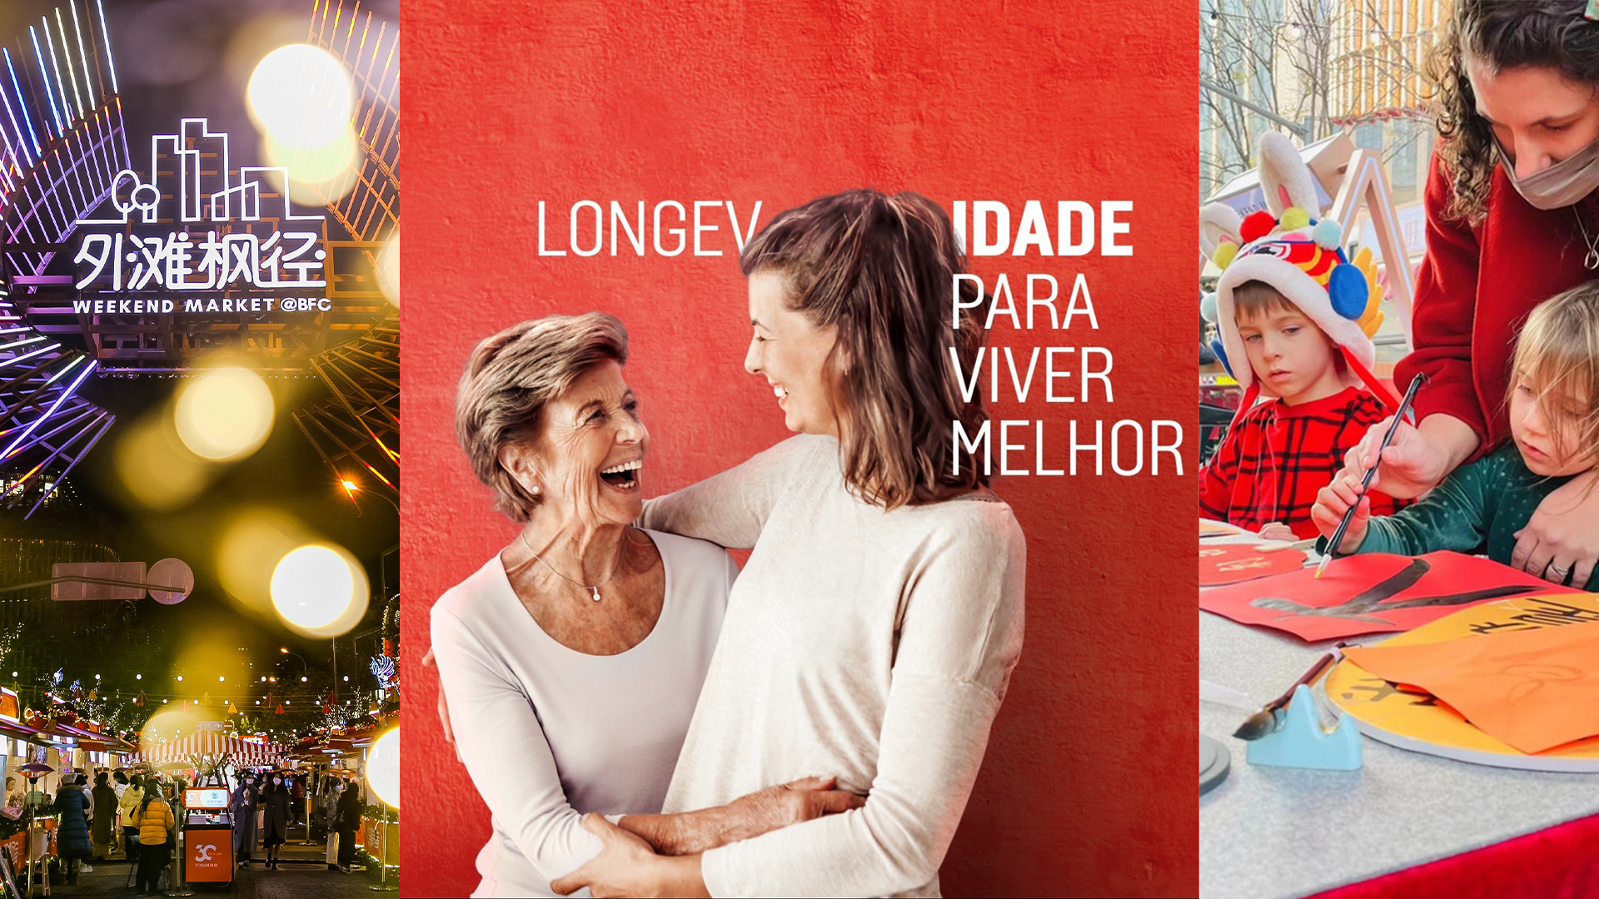

WEALTH
Insurance + financial resources and asset management capabilities empower each other
to create a closed-loop wealth ecosystem

Slide 16



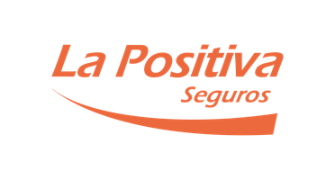


INSURANCE
Establish a global presence and adhere to innovative development and insurance ecosystem development
RMB60.3 billion
Premium
RMB160.7 billion
Investable assets
29.6%
Fosun Portugal Insurance’s market share in Portugal in 2022
1 million+
Number of registered users of My Fidelidade APP

Slide 17
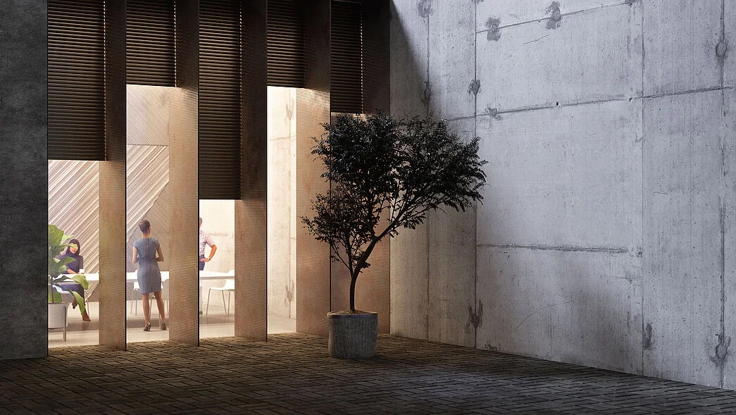


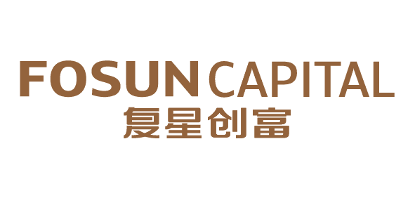




INVESTMENT MANAGEMENT
Industrial investment + financial investment as twin-driver to empower Health, Happiness, Wealth, and Intelligent Manufacturing in every stage of life
EUR257 billion
Assets under HAL’s service and management
+12%
Growth in assets under HAL’s service and management
HAL is committed to developing into the one of the top three private banks in Germany, with a focus on managing, maintaining, servicing and trading assets for clients
EUR1.86 billion
BCP’s consolidated core net income
+44.4%
BCP’s yoy consolidated core net income growth
Millennium bcp, the largest private bank in Portugal, provides commercial banking products and services to individuals and corporations, complemented by investment banking and private banking segments. It also owns ActivoBank, a leading digital bank
China’s Top 6 Most Recognized Private Equity Firms by LPs in 2022
China’s Top 11 Private Equity Firms in 2022
Fosun Capital
China’s Top 100 Venture Capital Firms in 2022
Fosun RZ Capital

Slide 18

HIVE
Introduce industries to cities to facilitate urban development, creating a global urban hive benchmark
TRAVEL & LEISURE HIVE
HEALTHCARE HIVE
INNOVATION HIVE
FINANCIAL SERVICE HIVE
CULTURE & ENTERTAINMENT HIVE
THE GRAND YUYUAN
40+
130+
A global fashion cultural zone showcasing the charm of oriental lifestyle aesthetics
Cities
Projects
Fosun Hive, as an advocate and practitioner of the advanced outlook on sustainable development of the industry, focuses on the needs for industrial upgrading in urban development and relies on Fosun's global industrial resources to provide diversified, multi-form and multi-level customized industrial development solutions underpinned by industrial way of thinking.
The Grand Yuyuan includes Phase I and Phase II of Yuyuan, the land plot on Fuyou Road, and the Grand Yuyuan of the Bund Finance Center, providing an excellent space to showcase oriental lifestyle aesthetics. In the future, through the promotion of traditional culture, industrial transformation and upgrading, and the organic integration of modern residential functions, the Grand Yuyuan will be built into a gathering place for oriental lifestyle aesthetics, facilitating the construction of Shanghai's international fashion capital and comprehensively enhancing the soft power of Shanghai.

Slide 19
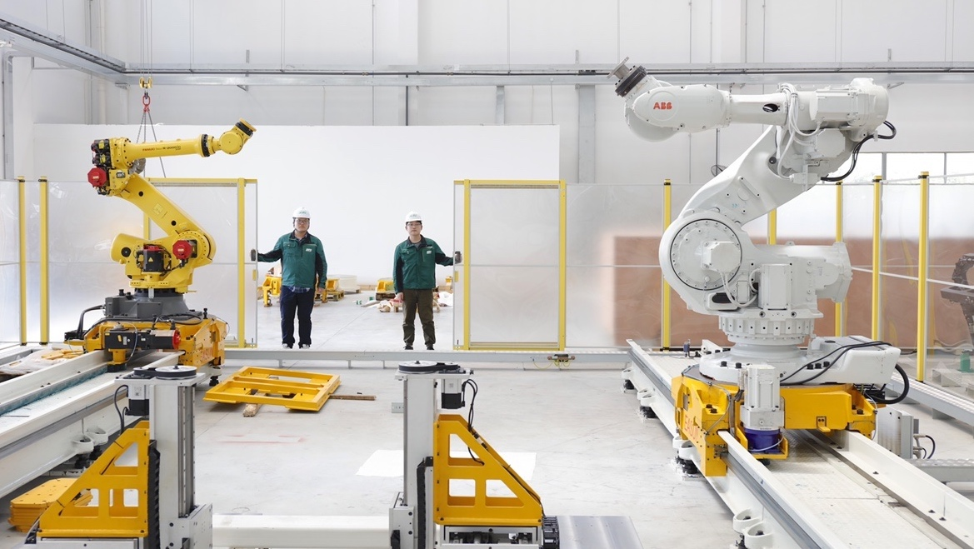

INTELLIGENT
MANUFACTURING
Develop digital intelligence globally
to empower industrial manufacturing

Slide 20
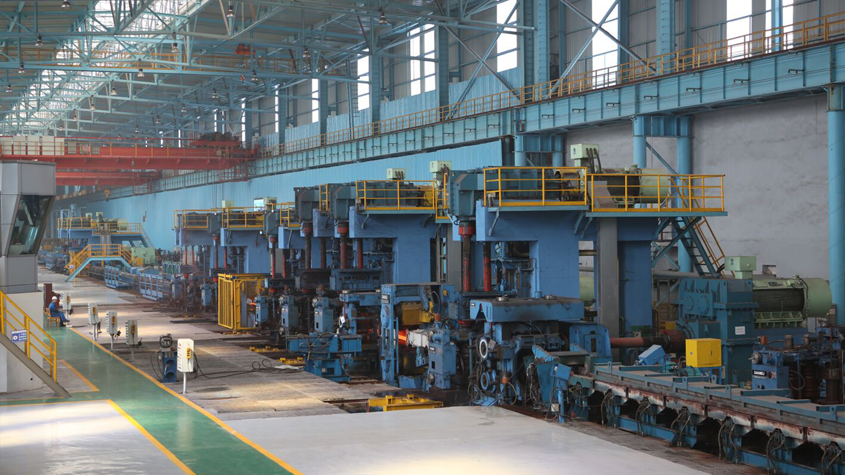






INDUSTRIAL LANDSCAPE
INTELLIGENT MANUFACTURING INDUSTRY
GREEN RESOURCE INDUSTRY
NEW CHEMICAL MATERIALS
INDUSTRIAL DIGITALIZATION AND AUTOMATION
VEHICLE ELECTRIFICATION AND INTELLIGENCE
RESOURCE
MINING
复睿微电子
Achieve breakthrough in core technology of advanced materials to upgrade the service manufacturing industry
A leader of intelligent manufacturing system, helping the intelligent transformation of the manufacturing industry
Grasp strategic opportunities in the mobility industry to create an integrated solution for intelligent mobility
Leverage the mining business, oil and gas resources
to deploy the carbon peak and carbon neutrality green industry
EMPOWERING UPGRADE, INTELLIGENCE, AND GREEN TRANSFORMATION OF THE M-END
70.667 billion
Nanjing Iron & Steel’s revenue in 2022
4.83 billion
Hainan Mining’s revenue in 2022,
+17.26%yoy
20,000 tons
The battery-grade lithium hydroxide project invested by Hainan Mining has begun construction
3.56 billion
Wansheng Co.’s revenue in 2022
More than 80%
Yoy growth of FFT (Shanghai)’s newly signed orders during the reporting period

Slide 21


FOCUSED STRATEGY TO EMPOWER THE SUSTAINABLE GROWTH:
FOUR CORE COMPETENCIES TO DRIVE CORPORATE GROWTH
PROFOUND GLOBAL OPERATIONS
INNOVATION-DRIVEN
Combining global resources with global growth momentum
Driven by China and the World
Global organization + local operations
Driven by product innovation
Driven by digital intelligence innovation
Driven by management innovation
FC2M¹ ECOSYSTEM
FES SYSTEM
Improve C2M capabilities and create species
Link species, form ecosystem, and achieve multiplier growth
Enhance industrial capabilities through comprehensive digital intelligence to connect all ecosystems
Fosun Entrepreneurship / Ecosystem System
Provide systematic methodology, tools and processes to realize
Fosun’s globalization, innovation and ecosystem operation
Improve operational capabilities to create a sustainable operation system
¹ FC2M: “F” represents Fosun and family, C2M represents Client to Maker

Slide 22
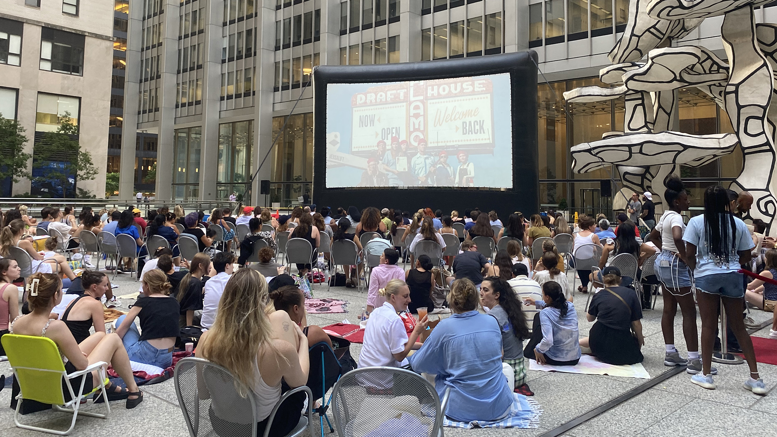





PROFOUND GLOBAL OPERATIONS
FRANCE
Club Med
LANVIN
TRIDEM
PAREF
DJULA
St Hubert
U.K.
Wolverhampton Wanderers F.C.
Thomas Cook
Resolution Property
Silver Cross
GERMANY
HAL
FFT
NAGA
Koller
Tom Tailor
ISRAEL
Sisram Med
AHAVA
BELGIUM
IGI
RUSSIA
Fosun Eurasia
CHINA
Fosun Pharma
Shanghai Henlius
Sinopharm Group
Starcastle Senior Living
Yuyuan
Laomiao
Shede Spirits
Fosun Tourism Group
Atlantis Sanya
Pramerica Fosun Life Insurance
Fosun Wealth
Fosun RZ Capital
Fosun Capital
BFC
Nanjing Iron & Steel
Hainang Mining
Easun Technology
JEVE
Wansheng Co.
AUSTRIA
Wolford
U.S.
28 Liberty
Fourtrees
Everest
St. John
WEI Beauty
GLOBAL FOOTPRINTS
GLOBAL BUSINESSES
GLOBAL INNOVATION
GLOBAL TALENTS
Established profound industry operations in nearly 35 countries and regions across five continents in the world
More than 40% of the revenue comes from countries/regions outside China
Focus on the Americas, Africa, India and Europe, build differentiated regional and global capabilities
More than 20 overseas partners among over 150 global partners
PERU
La Positiva
ITALY
The Medelan
Sergio Rossi
Caruso
BRAZIL
Rio Bravo
Guide
SINGAPORE
Fosun Hive Capital Management
PORTUGAL
Fidelidade
BCP
Luz Saúde
Fosun Hive Iberia
INDIA
Gland Pharma
Delhivery
HCZ
AUSTRALIA
Roc Oil
JAPAN
IDERA
Tomamu
The Court
MIRAI

Slide 23
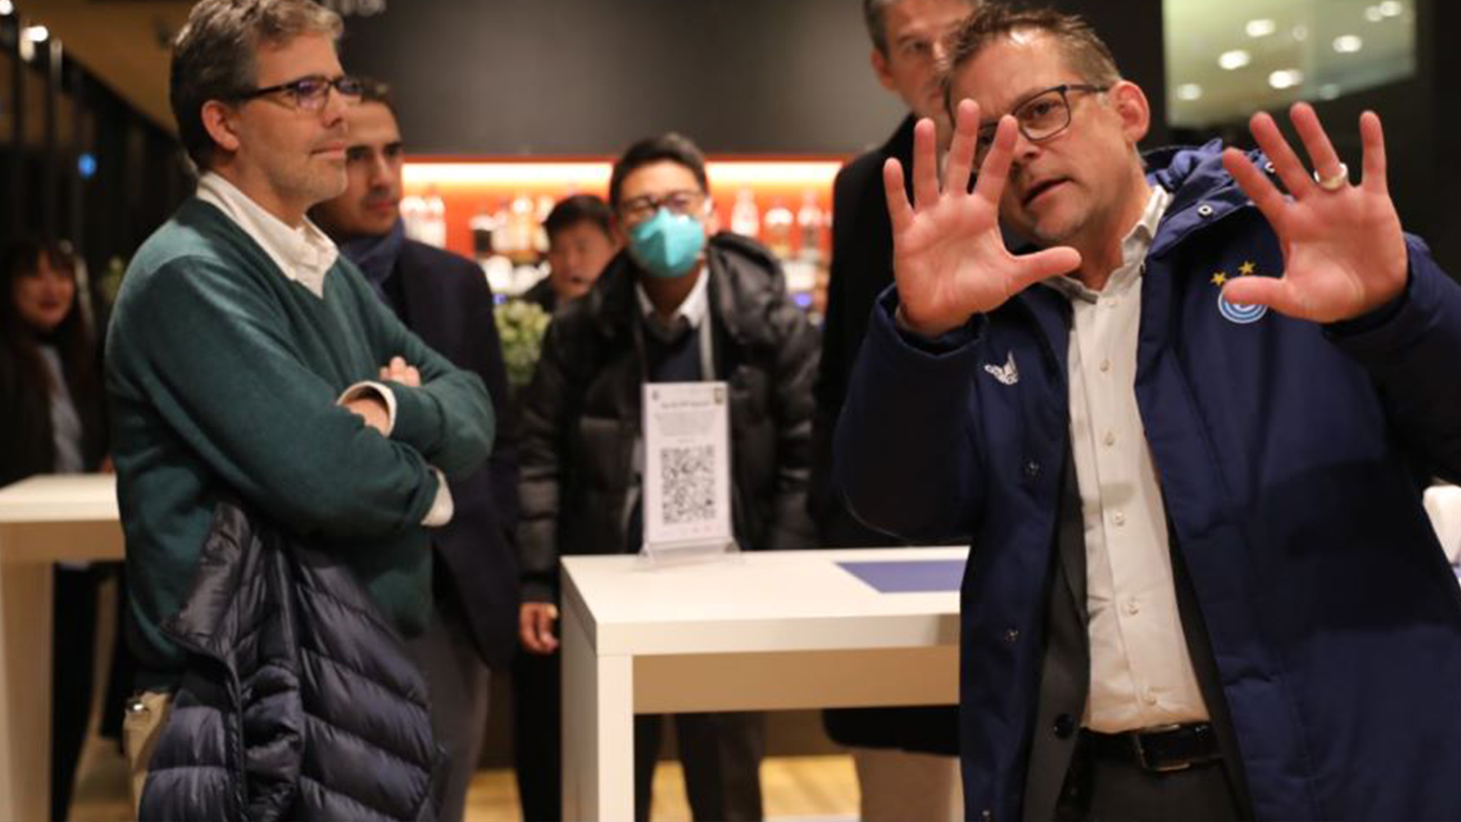
PROFOUND GLOBAL OPERATIONS
2010-Beginning: Globalization 1.0
Combining China’s growth momentum with global resources
2017-Deepening: Globalization 2.0
Mutual empowerment between China and the world
2022-Evolution: Globalization 3.0
Global organization + local operations
44%
Sales revenue from overseas
countries and regions
35+
Countries and regions with
revenue exceeding 100 million
40+
Overseas brand enterprises
20+
Overseas global partners
45,000+
Overseas employees
Cross-cultural and cross-organizational capability
Digital intelligence capability
FES global management and operation system
Global innovation capability
Global investment capability

Slide 24
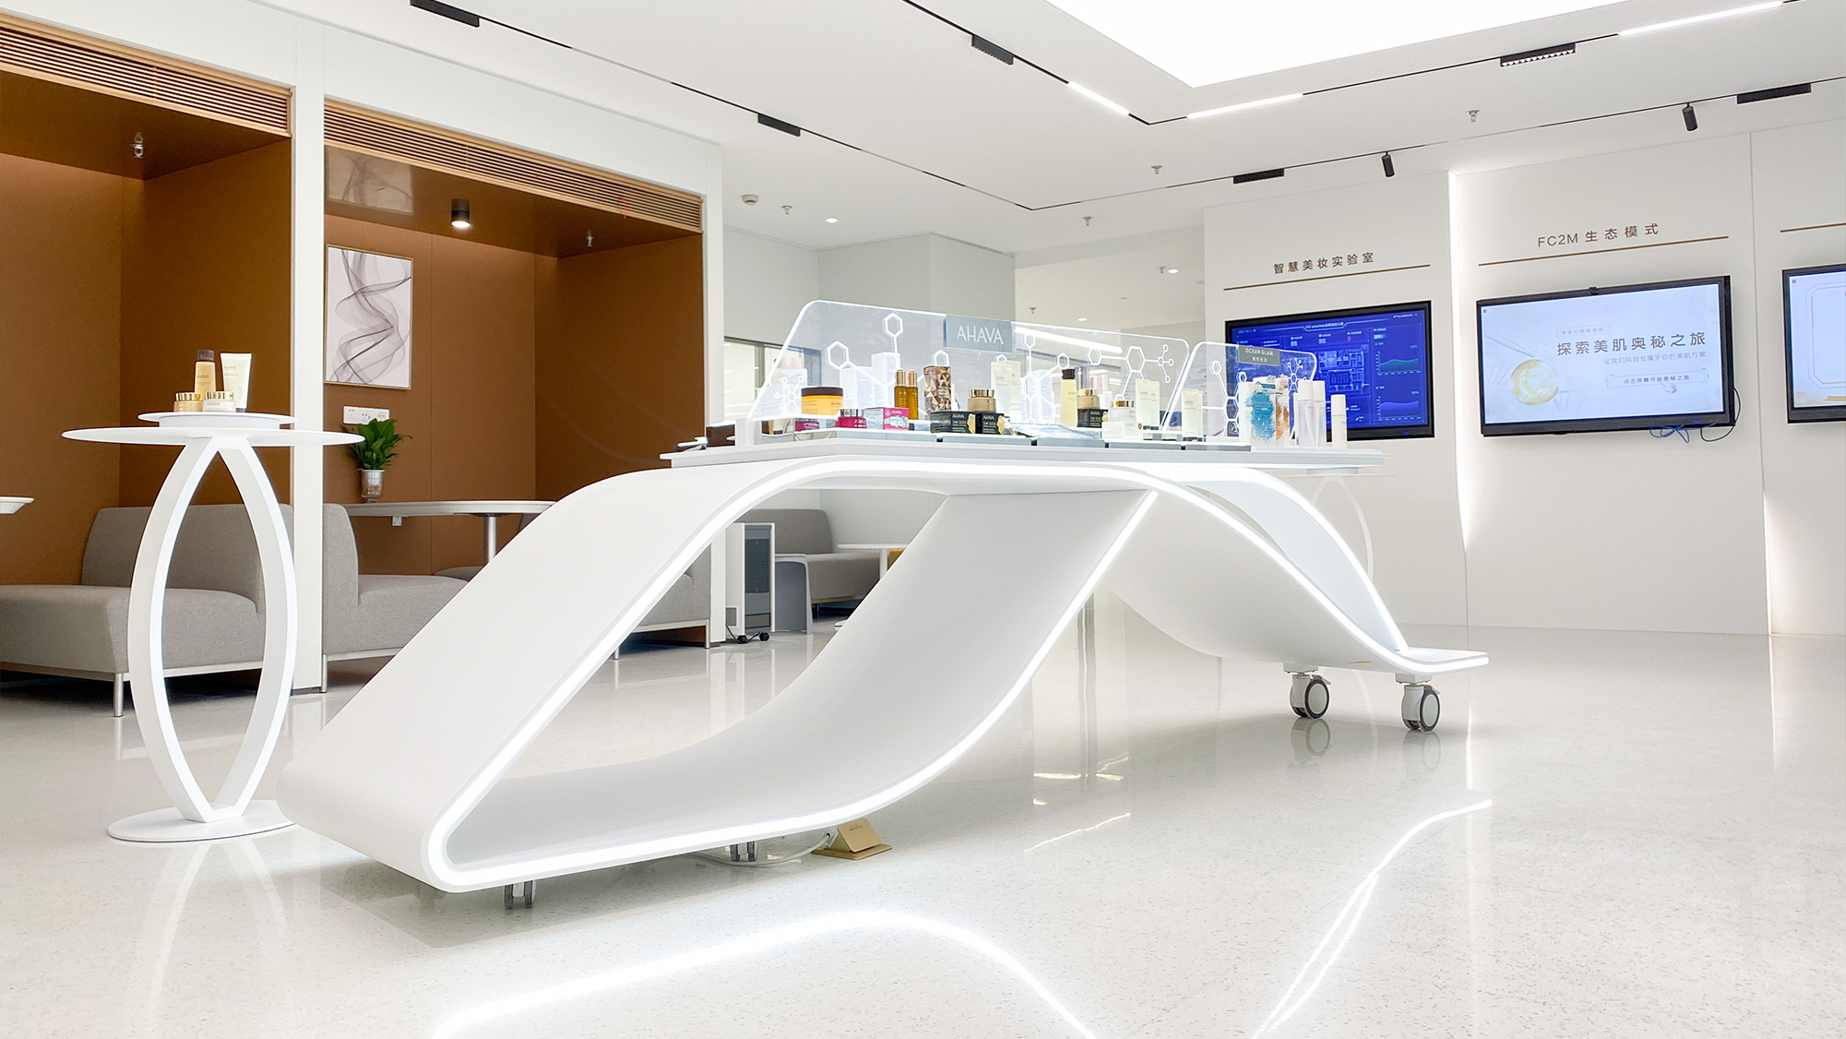









INNOVATION-DRIVEN
R&D investment in 2022
Han Si Zhuang 汉斯状®
10.4
1771
10+
The world's first anti-PD-1 monoclonal antibody for first-line treatment of small cell lung cancer
Three indications have been approved in China (excluding Hong Kong SAR, Macau SAR and Taiwan region)
billion¹
Yi Kai Da 奕凯达®
Strengthen technology
innovation capability
Patents for inventions
Global technology
innovation centers
The first CAR-T cell therapy approved for launch in Chinese mainland
The indication for second-line treatment of adult large B-cell lymphoma was accepted in China (excluding Hong Kong SAR, Macau SAR and Taiwan region) and has been included in the list of priority review products
(RMB)
13-valent pneumococcal conjugate vaccine
LEADING
CORE TECHNOLOGIES IN VARIOUS FIELDS
INNOVATIVE
TECHNOLOGY INNOVATION CENTERS IN VARIOUS FIELDS
Phase III clinical trial commenced in China (excluding Hong Kong SAR, Macau SAR and Taiwan region)
YOGAN 愈感
Innovative drug: focus on core therapeutic areas such as oncology, immunology, central nervous system, and chronic disease, and mainly strengthen core technology platforms such as small molecule, antibody/ADC, cell therapy, and RNA
Vaccine: platforms of bacterial vaccine + viral vaccine
Device: three major platforms of medical cosmetology + respiratory health + professional medical care
Research and application of oriental lifestyle aesthetics
Construction of the 4D technology innovation system: five senses of consumers + technology innovation R&D + creative design + technology innovation digitalization
Insurance: digital platform optimizes customer experience throughout the life cycle
Intelligent travel: full-stack self-developed L2+ intelligent driving software and hardware solutions
Industrial automation: leveraging digital twin, machine vision and other technologies accumulated for many years in the industry, AIGC large models are introduced to promote the industry's fully intelligence and automation
New energy: from traditional energy to the upstream extension of new energy and new materials
The first self-developed skin care brand for sensitive skin, YOGAN was launched
Fosun Pharma Global R&D Center (national level)
JEVE Technology Center (national level)
Wanbang Biopharma Quality Department QC Lab² (CNAS certified)
Fosun Jinmei Global Technology Innovation Center²
Fosun Pharma North America R&D Headquarters
Shanghai Key Laboratory of Stem Cell Therapy
Sichuan Engineering Technology Center for Intelligent Brewing of Baiju
Lanvin Group Design Center (Milan,Italy and the U.K.)
Yuyuan Jewelry Creative House
Yuyuan Food & Culture Group Innovation Center Base
Academician Enterprise Research Institute
…
Shede Spirits
Tackling the technical solution of "upgrading and processing base spirit with special new materials that maintain the characteristics of the aged base spirit"
Fidelidade
The number of registered users of My Fidelidade APP exceeded 1 million, the proportion of medical reimbursement on the APP accounted for > 46%, and the proportion of digital auto insurance claims > 48%
Fusionride Technology
Launched a fusion sensing solution centered on high-performance 4D millimeter-wave radar
Easun Technology
The self-developed new energy system was delivered to major overseas customers for the first time
Hainan Mining
The 20,000-ton lithium hydroxide project (Phase I) invested by Hainan Mining has begun construction.
Hainan Mining is actively promoting the merger and acquisition and development of the Bougouni lithium mine in Mali, Africa
¹ It includes scientific research investment (expensed and capitalized), but excludes digitalization expenses
² Application of CNAS (China National Accreditation Service for Conformity Assessment) certified laboratory is in progress

Slide 25
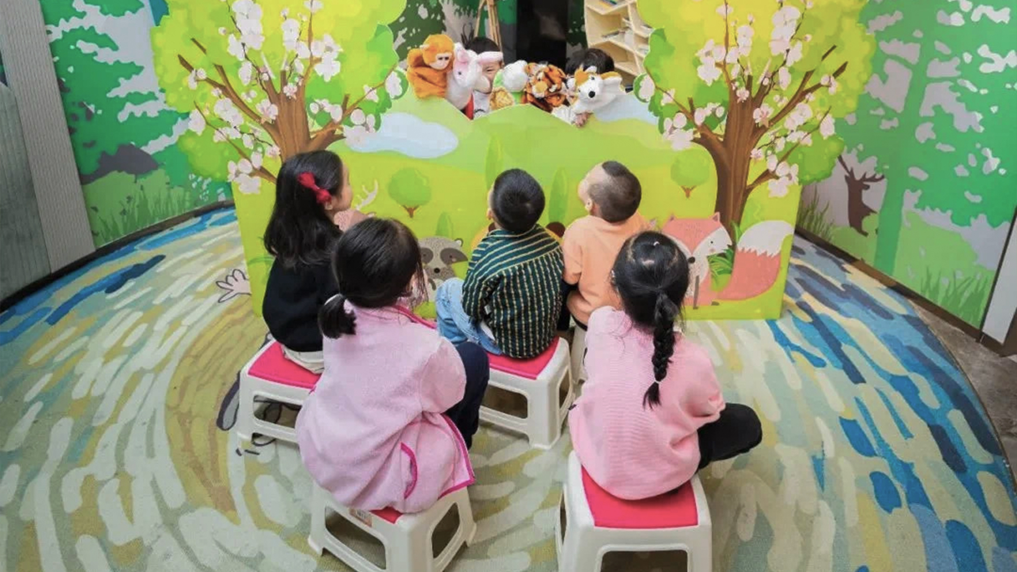
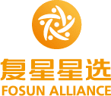


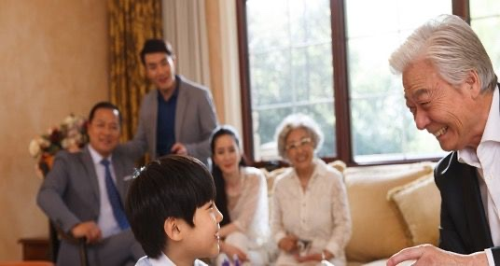
FC2M ECOSYSTEM
Membership platform of Fosun’s ecosystem
Medical-grade, all-scenario,
one-stop health ecosystem
SCENARIOS
PLATFORMS
INDUSTRIES
464 million
6.9 billion (RMB)
133
22.58 million
6.40 million
Cumulative number of operational members¹, an increase of 50.80 million members compared to 2021
Total value created by the Group’s ecosystem²
Products with sales exceeding RMB100 million
Cumulative number of registered members of Fosun Health with 9.24 million new registered users in 2022
Cumulative number of registered members of Fosun Alliance, and the transaction conversion rate³ under accurate recommendation increased by 26%
F
C2M
FOSUN/FAMILY
CLIENTS
LINK
PRODUCTS & SERVICES
¹ Operational members: customers who have agreed to the official membership terms of the brand and granted privacy in any channel, and actively retained personal information including mobile phone numbers, to meet the needs of identifiable, reachable and traceable consumers are defined as registered members (i.e. operational members). From 2022 onwards, this statistic includes consumers in the Fosun Health ecosystem
² It refers to the revenue contribution (before intercompany eliminations) directly or indirectly created by companies within the Fosun ecosystem for other companies within the ecosystem, including but not limited to cross-selling, product co-creation, membership contribution, membership sales transformation, and sales collaboration within the ecosystem, joint industrial investment, financing cooperation empowerment, industrial resource coordination, etc.
³ It refers to order conversion rate, facilitating order placement by sending marketing materials to users, as calculated by “number of users placing orders/number of users reached”

Slide 26
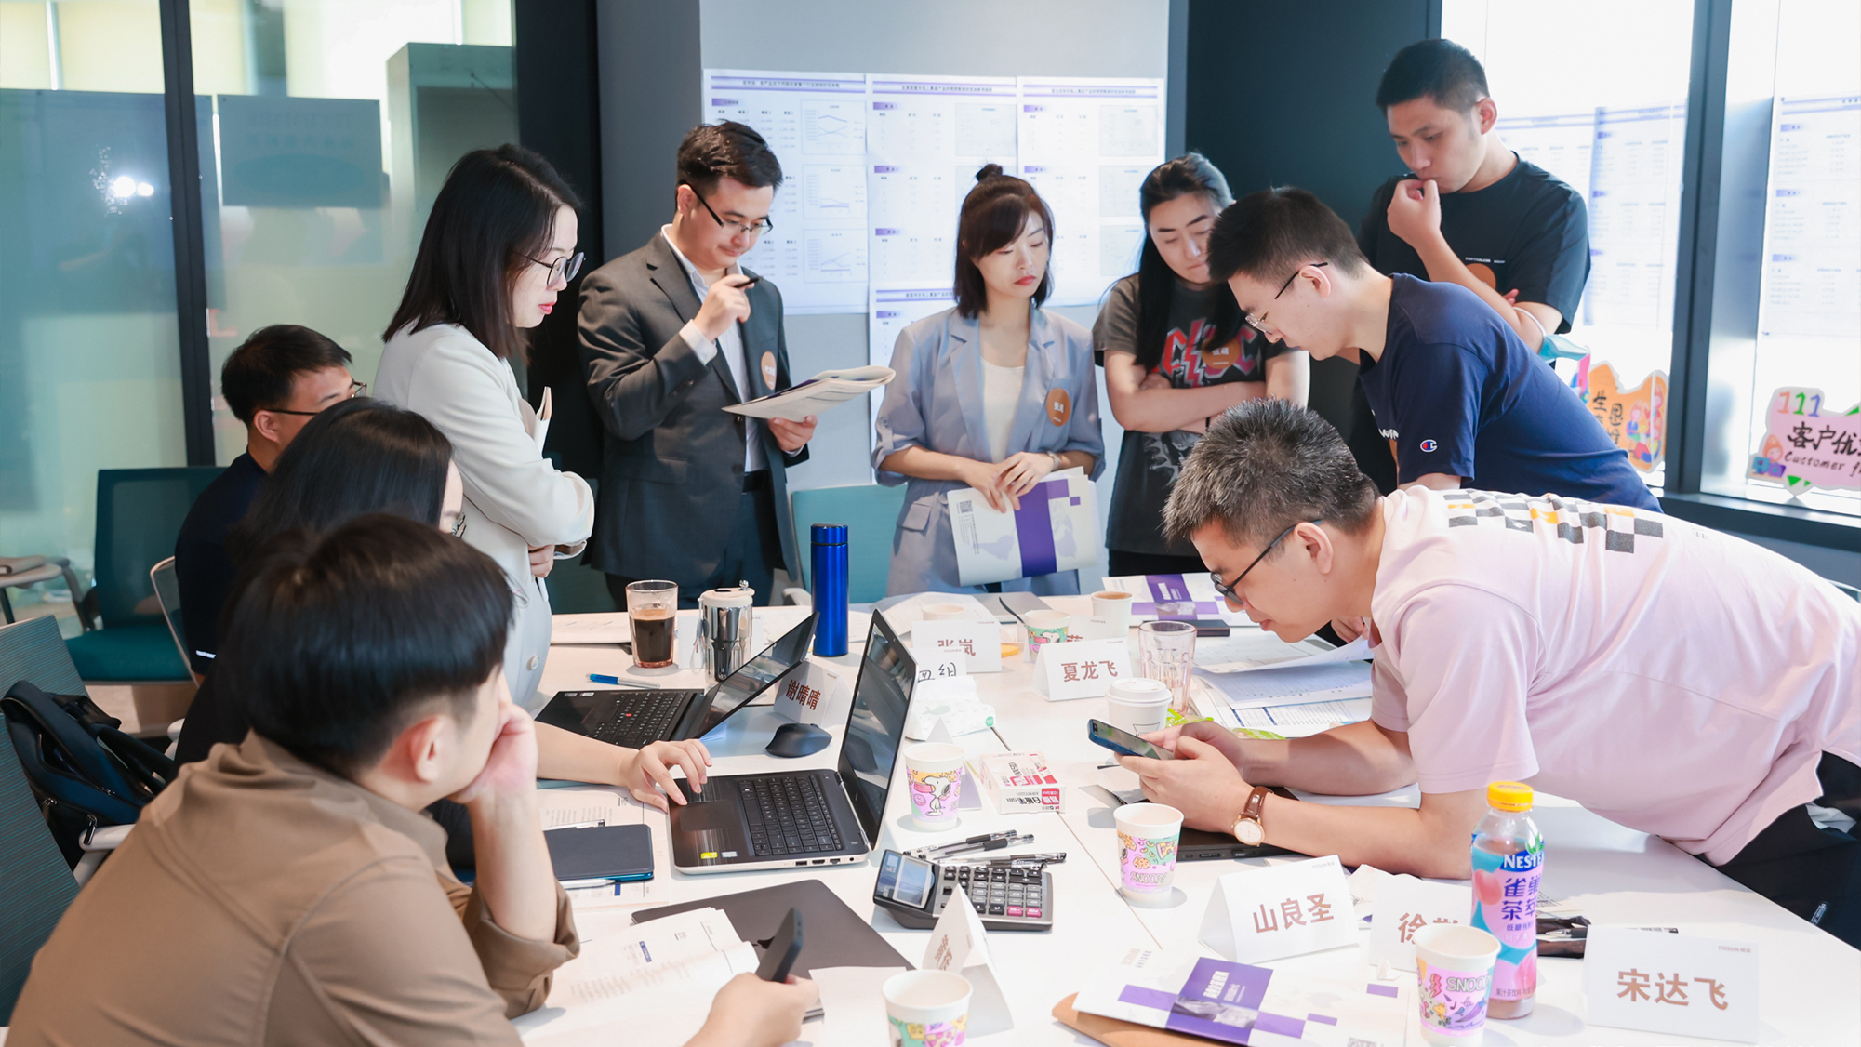
FES SYSTEM
FES
The FES system is a continuously evolving management system that helps Fosun build core competitiveness of a longstanding enterprise and nurture talents with Fosun’s entrepreneurship. The system provides Fosun with systematic methodology, tools, and processes to realize Fosun’s global operations capabilities, globalization, technology innovation and smooth operation of Fosun’s ecosystem. With the joint effort of all employees, a corporate culture of continuous improvement and continuous growth will be established, promoting the contribution of the “Power of Fosun” to the development of the whole society
(FOSUN ENTREPRENEURSHIP / ECOSYSTEM SYSTEM)
PROFOUND
INDUSTRIAL
DEVELOPMENT
Ecosystem | Synergy
ENTREPRENEURIAL
ORGANIZATION
ENTREPRENENURSHIP
MULTIPLIER GROWTH
ECOSYSTEM
LEAN
OPERATIONS
PROFIT
CASH FLOW
FIVE
MODULES
VALUE
GROWTH
RISK
MANAGEMENT
Accumulation
FES
Practice
100+
Professional tools
700+
Expert certifications annually
BUSINESS
OPERATIONS
Management | Process
INVESTMENT
AND M&A
Strategies | Sectors
40+
100+
FES best practice cases
GROWTH
Improvement activities annually
PROFOUND INDUSTRY OPERATIONS + INDUSTRIAL INVESTMENT

Slide 27
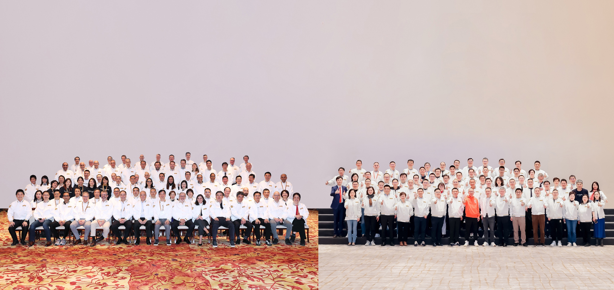
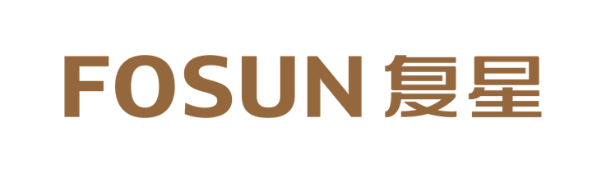
TALENTS, THE MOST VALUABLE ASSET OF FOSUN
A ROBUST TEAM OF TALENTS DETERMINES THE SCALABILITY OF THE COMPANY’S FUTURE DEVELOPMENT
ELITE MANAGEMENT TEAM
GLOCAL
TALENT DEVELOPMENT STRATEGY
150+ global partners, 280+ industry partners,
400+ function line partners, 70+ innovation partners,
with regular rotation to deeply involve in each project, sector, and region
20+ overseas global partners coming from countries including Portugal, France, Germany, the U.K., Japan, India, and the U.S.
Attract talents with development, appraise talents based on performance, train talents through work, and unite talents with career opportunities

Slide 28
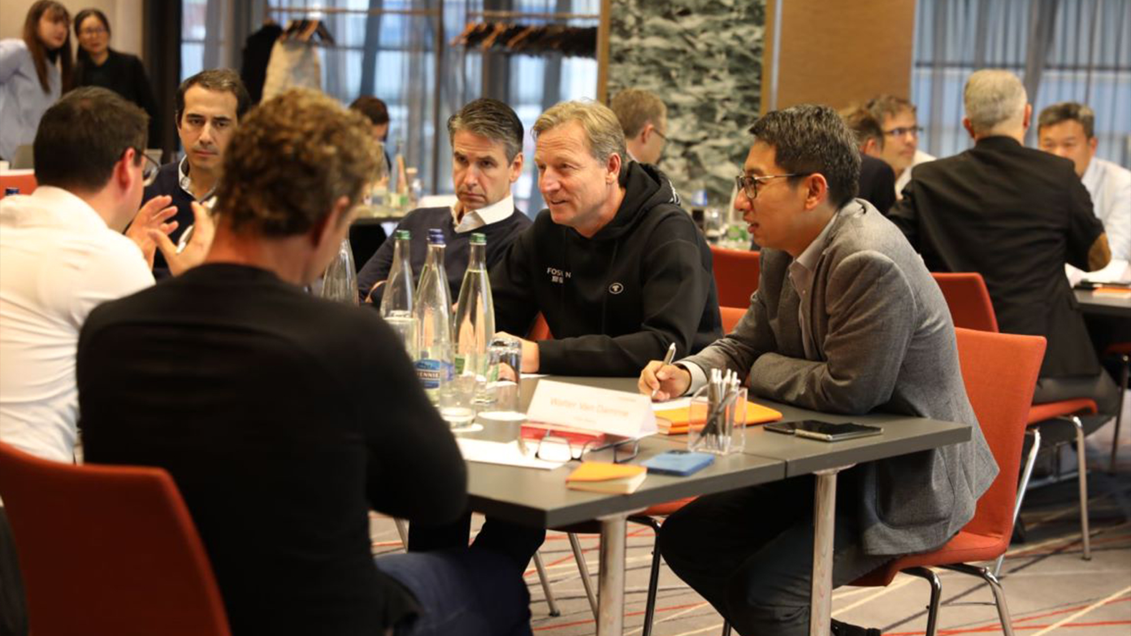





FOCUS ON KEY TALENTS TO BUILD A TEAM WITH ENTREPRENEURIAL SPIRITS
Consolidate the multi-level partner mechanism to form an elite partner echelon and lead key talents to manage the system
FOSUN GLOBAL PARTNERS
MID-LEVEL ENTREPRENEURS
FUTURE ENTREPRENEURS
TECHNOLOGY INNOVATION TALENTS
300 +
Future Fosun global partners
3000 +
Future entrepreneur backups
30%
High-potential talents
100 +
Top scientists of Fosun ecosystem
FUTURE FOSUN GLOBAL PARTNER BACKUPS
Build a ‘pyramid-shaped’ partner backup array,
forming a competitive dynamic partnership management mechanism that allows talent appraisals at different levels according to their performance

Slide 29
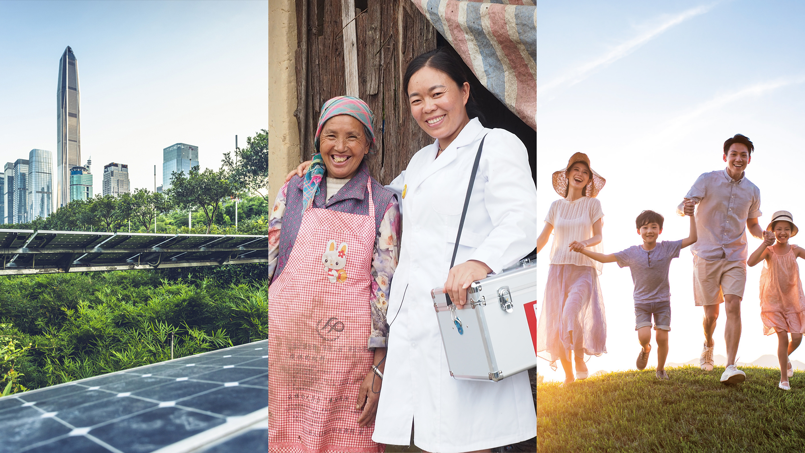
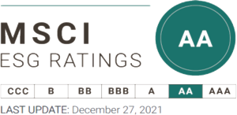





REMARKABLE ESG ACHIEVEMENTS FOR A BRIGHTER LIFE
The only conglomerate in Greater China with a MSCI ESG rating of AA
Hang Seng Corporate
Sustainability Index Series
S&P CSA ESG score outperformed 91% of global peers and was significantly above the industry average score
Selected as one of the constituents of FTSE4Good Index Series for the first time in 2022
A
ESG RATINGS CONTINUED TO IMPROVE IN 2022
E
S
G
CARBON NEUTRALITY STRATEGY
FOSUN FOR GOOD
CORPORATE GOVERNANCE
Achieve carbon neutrality goal by 2050
EHS management framework
Climate risk response
Rural Doctors Program
Assist the World Health Organization (WHO) in building
a malaria-free world
“Drug + vaccine” to fight the pandemic
Continue to optimize and evolve corporate risk management
Improve ESG governance structure with the new establishment of an ESG Executive Committee and an ESG Management Committee
Actively communicate with external investors and rating agencies on ESG issues

Slide 30
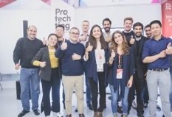
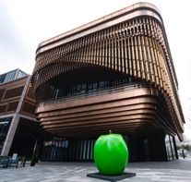
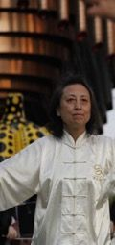


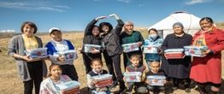
FOSUN FOR GOOD
RURAL DOCTORS POVERTY
ALLEVIATION PROGRAM
FOSUN FOUNDATION (SHANGHAI)
YOUTH ENTREPRENEURSHIP
Up to now, the program has covered 73 counties in 16 provinces, municipalities, and autonomous regions
Sent a total of 226 staff to assist the counties
Served approx. 24,000 rural doctors
Benefited 3 million grassroots families
Fosun Foundation (Shanghai) is a non-profit organization
launched and supported by the Fosun Group and Fosun Foundation. Its programs are characterized by contemporary, international, and highly interactive artworks. It has held a total of 26 art exhibitions and has attracted more than 1.62 million visitors since 2016
ARTS & CULTURE
ASSIST AFRICA IN FIGHTING AGAINST MALARIA
HEALTH
EDUCATION
Fosun Pharma supplied over 280 million artesunate
injections to the international market, benefited over 56 million patients with severe malaria
TAI CHI ANTI-PARKINSON’S DISEASE,
TAI CHI FOR DELAYING ALZHEIMER’S DISEASE
RURAL REVITALIZATION
The scientific research findings of Tai Chi as an adjuvant therapy for chronic diseases were published in international authoritative journals
Organized 3144 hours of Tai Chi charitable courses for 445 patients with Parkinson’s disease since 2015
Organized 945.5 hours of online Tai Chi charitable courses, benefited 23491 people since 2020
PROTECHTING
GLOBAL YOUTH START-UP ACCELERATION PROGRAM
The Fosun Foundation was established in November 2012 as the main humanitarian arm of
the Fosun Group and is a “5A Social Organization”. Adhering to Fosun‘s philosophy of “Self-improvement, Teamwork, Performance and Contribution to Society”, Fosun Foundation insists on serving the society, the people and the nation. The coverage of the foundation includes disaster relief, healthcare, poverty alleviation, rural revitalization, education, community building, youth entrepreneurship and culture, art, etc., serving many countries and regions around the world
Received 896 applications from 40+ countries and regions since 2016
Won 3 international awards in recognition of its corporate social responsibility
33 closely cooperated start-up projects
5 companies signed commercial contracts

Slide 31
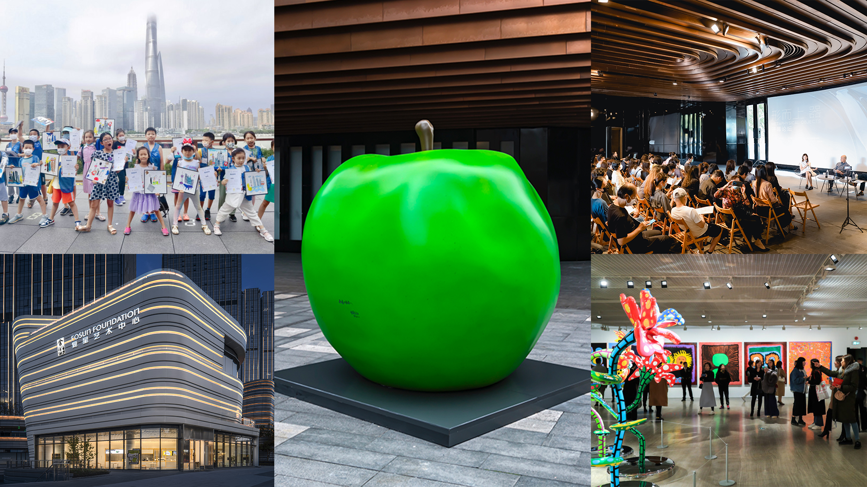

FOSUN FOUNDATION (SHANGHAI)
Fosun Foundation (Shanghai) aims to promote contemporary art and is committed to binding Chinese and international art and culture, and promote public awareness, understanding and engagement in global contemporary art. Fosun Foundation (Shanghai) continues to support local Chinese artists, providing a broad display platform for outstanding Chinese contemporary art works. Fosun Foundation (Shanghai) is located in the Bund Finance Center. Fosun Foundation (Chengdu) was opened in June 2022. Fosun Foundation (Shanghai) participates in, witnesses and leads the development of contemporary art and culture. As an art consultant, Fosun Foundation (Shanghai) has long showcased its collection of Chinese art works in global landmark buildings such as Liberty 28 in New York to promote global cultural and artistic exchanges
The first 3A social
organization among
Shanghai contemporary art
institutions
26 art exhibitions
1.62 million+ visitors
Committed to presenting international and Chinese contemporary art exhibitions and special exhibitions with rich content, including “Tadao Ando: Endeavors”, “Yayoi Kusama: All About Love Speaks Forever”, etc.
500 public education campaigns
39120+ participants in public education campaigns
The first governing unit of
Shanghai Art Museum
Association
Insist on organizing high-quality public education campaigns to help the public understand art and promote active participation in art-related events
370+ Fosun Foundation (Shanghai) Night and Aesthetic Journey
Shanghai Municipal Administration of
Culture and Tourism's "Civilization
and Integrity, Art Appreciation" co-construction
unit, Shanghai Public
Welfare Base, Donghua University
Aesthetic Education Practice Base
Organize diversified and comprehensive cross-brand activities to promote public awareness and public engagement in the latest contemporary art trends

Slide 32
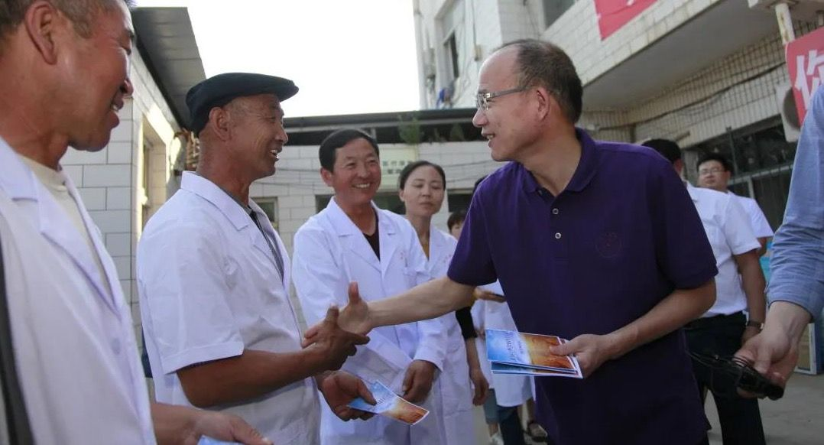
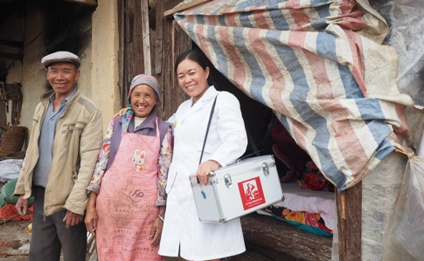



RURAL DOCTORS PROGRAM
Delivering hope to impoverished people in rural areas
The Rural Doctors Program is one of the key initiatives to realize the goal of common prosperity. In late 2017, under the guidance of the National Health Commission Poverty Relief Office, Fosun Foundation, together with China Population Welfare Foundation, etc., initiated the Rural Doctors Poverty Alleviation Program (“Rural Doctors Program”) to empower millions of rural doctors who are working in the frontlines, thereby accelerating the realization of Healthy China
6 years, 315
16
73
On-site workers
Provinces, cities, autonomous regions covered across the country
Key national poverty-stricken counties
(including 13 counties in Three Regions and Three Prefectures in extreme poverty, which have all been lifted out of poverty)
12545
23956
3 million
Administrative village clinics assisted
Rural doctors served
Grassroots families benefited
The Rural Doctors Program was awarded the "China Charity Award" in September 2021 and the “Shanghai Charity Award” in December 2022

Slide 33


FIGHT AGAINST MALARIA IN AFRICA
Assisting in building a “malaria-free world”
280 million +
56 million +
The number of vials of artesunate for injection (60mg) that Fosun Pharma
supplied to the global market since 2005, according to incomplete statistics
The number of patients with severe malaria that Artesun® (artesunate for
injection) has saved
175 million
The number of children in high malaria transmission African countries benefited
from SPAQ-CO ®Disp, a malaria prevention drug for children which was prequalified by the WHO
“We will join forces and work with anti-malaria experts as well as other parties to continue to carry out malaria education projects for the public and raise the public awareness of malaria prevention. We will also actively participate in public health improvement and make steady efforts to build a malaria-free world.”
Guo Guangchang

Slide 34




TAI CHI ANTI-PARKINSON’S DISEASE,
TAI CHI FOR DELAYING ALZHEIMER’S DISEASE
Slow therapy for chronic disease to hold on to the good memories
Fosun Foundation cooperated with the Neurology Department of Ruijin Hospital to jointly launch “Tai Chi Anti-Parkinson’s Disease” and “Tai Chi for Delaying Alzheimer’s Disease”
In 2018, the research article titled “Reduction of HIP2 expression causes motor function impairment and increased vulnerability to dopaminergic degeneration in Parkinson’s disease models” was published in Cell Death & Disease
TAI CHI ANTI-PARKINSON’S DISEASE
520
3144 hours
945.5 hours
23491
Offline
Online
Participants online
Patients with Parkinson’s
disease served since 2015
TAI CHI FOR DELAYING ALZHEIMER’S DISEASE
53
167.5 hours
In February 2022, the research article titled “Mechanisms of motor symptom improvement by long-term Tai Chi training in Parkinson’s disease patients” was published in Translational Neurodegeneration
Patients with Alzheimer’s disease served
Tai chi charitable course organized (offline)
COMMUNITY TAI CHI VOLUNTEER INSTRUCTOR TRAINING
5
147
1764
88
Communities served
Elders served
Participants
Tai chi volunteers trained
In March 2022, the research article titled “Tai Chi enhances cognitive training effects on delaying cognitive decline in mild cognitive impairment” was published in Alzheimer's & Dementia

Slide 35



FIGHT AGAINST COVID-19: STAY TRUE TO OUR ORIGINAL ASPIRATION AND CONTRIBUTE TO SOCIETY
ASSIST THE GLOBAL FIGHT AGAINST COVID-19
(From 24 January 2020 to 3 April 2023)
“DRUG + VACCINE” TO ASSIST THE GLOBAL FIGHT AGAINST COVID-19
31 million doses of Comirnaty
Donated Azvudine tablets to 250 counties and cities across the country
Had been administered in Hong Kong, Macau and Taiwan regions as of the end of February 2023
Following the rollout of the self-paid vaccination service of Comirnaty BNT162b2 original vaccine in Macau in 2022, the self-paid vaccination service for Comirnaty Bivalent Vaccine has been rolled out in Hong Kong and Macau in the first quarter of 2023, providing more vaccine options for people in need and helping to build a health protection barrier.
In 2022, Azvudine tablets, China's first small molecule oral medication for COVID-19 jointly developed by Fosun Pharma and Henan Genuine Biotech, was included in the national Diagnosis and Treatment Protocol for COVID-19 and was covered by the national medical insurance scheme. At the beginning of 2023, the Fosun Foundation, together with Fosun Pharma and Genuine Biotech, launched the campaign “A Healthy Winter Action” to donate Azvudine tablets to 250 counties and cities across the country, helping the grassroots weather the epidemic during the New Year.
SUPPORT CHINA’S FIGHT AGAINST COVID-19
Deployed nearly 3 million pieces of medical supplies globally
CONTRIBUTION TO SOCIETY
These strategic supplies provided strong support for China’s fight against COVID-19
When the COVID-19 pandemic broke out in early 2020 and China was in the most difficult time, Fosun leveraged its strong global resources deployment capability to source medical supplies from 23 countries
On 28 January 2020, the first batch of materials deployed by Fosun, 50,000 pieces of protective suits deployed from Germany, was delivered from Frankfurt to front-line medical staff in Wuhan and other front-line medical staff in just 5 days
147 million pieces
18000+
Medical supplies deployed; such as COVID-19 nucleic acid
testing kits, ventilators, face masks, protective suits, and
gloves, for humanitarian relief support against COVID-19
Ventilators put into use in the global flight against
COVID-19
Provided a total of more than 6.245 million pieces of materials in Shanghai’s battle against COVID-19
Assisted 30+ countries
20000+
100000
Fosun's self-developed COVID-19 nucleic acid detection kit has been certified by the China NMPA and the U.S. Food and Drug Administration (FDA), and obtained the European Union CE marking
Oxygen concentrators provided to support India’s fight against
COVID-19
Pieces of KN95
face masks
As of 9 June 2022, anti-epidemic materials donated by Fosun Foundation and its partners to support the three projects,
“Community Support”, “Care for Elderly” and “Care for Children” in Shanghai's battle against COVID-19
Over the past three years in the fight against the pandemic, Fosun has continued to assist Wuhan, Hubei, Nanjing, Beijing, Xi'an, Henan, Shanghai, Hong Kong, Shenzhen, Jilin, etc.

Slide 36



TOWARDS A BRIGHTER LIFE
HONG KONG |  | SHANGHAI
Room 808, ICBC Tower, 3 Garden Road, Central, Hong Kong |  | Bund Finance Center, No. 600, Zhongshan East 2nd Road, Huangpu District, Shanghai
Tel: | +852 2509 3228 | Tel: | +86 21 2315 6666
Fax: | +852 2509 9028 | Fax: | +86 21 6130 3288
 |  | Postal code: | 200010
A GLOBAL INNOVATION-DRIVEN CONSUMER GROUP
WeChat
Weibo
WeChat Channels

