Slide 1
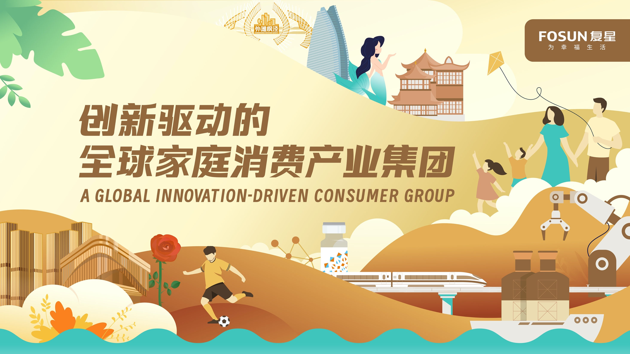

Slide 2

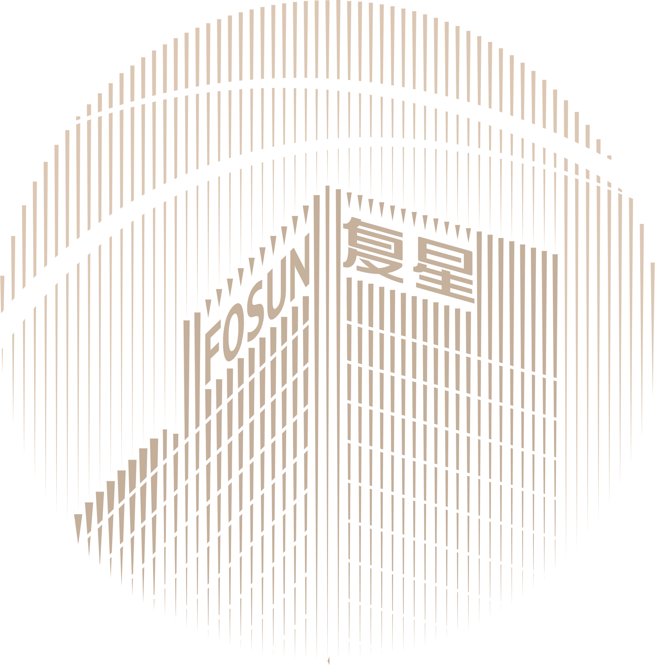




FOSUN, TOWARDS A BRIGHTER LIFE
MISSION
Creating happier lives for families worldwide
VISION
Rooted in China, Fosun is committed to creating a global happiness ecosystem fulfilling the needs of one billion families in Health, Happiness, and Wealth
VALUE
Self-improvement, Teamwork, Performance, and Contribution to Society

Slide 3


A GLOBAL INNOVATION-DRIVEN CONSUMER GROUP
Fosun was founded in 1992. Our mission is to provide high-quality products and services for families around the world in Health, Happiness, Wealth, and Intelligent Manufacturing segments.
¥
Total Revenue
Total Assets
Number of Employees
ESG Ratings
Global Operations
R&D Investment
Ecosystem Value¹
97.06
834.9
100000+
AA
35+
10.4
6.2
*
MSCI
（For the full year of 2022）
AA-
billion
billion
countries and regions
with revenue exceeding
RMB100 million
billion
billion
HSI
10+
（Sep 2023）
Global Technology Innovation Centers
* Currency in RMB and data as of 30 June 2023 unless otherwise specified
¹ It refers to the revenue contribution (before intercompany eliminations) directly or indirectly created by companies within the Fosun ecosystem for other companies with the ecosystem.

Slide 4


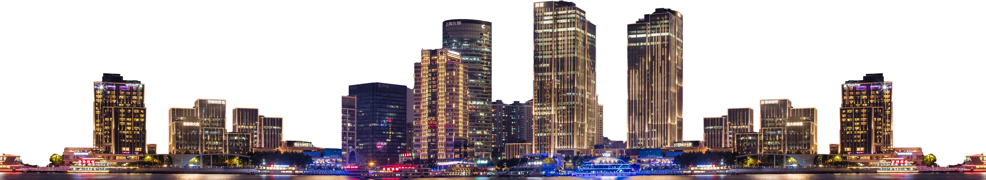
FOCUS ON CORE INDUSTRY OPERATIONS, OPTIMIZE CAPITAL AND ASSET STRUCTURE
¥
Industrial Operation Profit ¹
Industrial Operation Profit
Cash and Bank Balances and Term Deposits
Cash Inflow From Divestment ³
International Credit Rating
3.37
+66%
114.68
20.0
Stable
billion
yoy ²
billion
billion
Rating Outlook by S&P Global
1 It includes the profit contribution of industrial operation subsidiaries of the Group and associates and joint ventures accounted by equity method
2 Excluding the profit of disposed enterprises (including transactions yet to be completed), industrial profit for the first half of 2023 was RMB2.03 billion
3 It refers to cash received from divestment at the consolidated level

Slide 5



ROOTED IN CHINA, DEVELOPING GLOBALLY
2022
Listing of Lanvin Group on the New York Stock Exchange
Yelanggujiu
For more than 30 years, Fosun has implemented the twin-driver strategy of “profound industry operations + industrial investment" to strengthen its foothold in various industries. Through continuous innovation, Fosun has achieved rapid development by capitalizing on the opportunities and momentum of China and the world's economic development
2020
DJULA
WEI Beauty
Shede Spirits
2018
LANVIN
Wolford
Lovelink (formerly known as Baihe Jiayuan)
Songhelou
Listing of Fosun Tourism Group on the Hong Kong Stock Exchange
2012
Pramerica Fosun Life Insurance
Peak Re
Starcastle Senior Living
2016
Gland Pharma
HAL
Wolverhampton Wanderers Football Club
BabyTree
AHAVA
2010
Club Med
Shanghai Henlius
2014
Fidelidade
Luz Saúde
ROC
2003
Nanjing Iron & Steel
Sinopharm Group
1998
Listing of Fosun Pharma on the Shanghai Stock Exchange
1992
Fosun was founded with a capital of RMB38,000
2007
Hainan Mining
Listing of Fosun International (00656.HK) on the Hong Kong Stock Exchange
1994
Fosun Pharma
Forte
2002
Yuyuan
2011
BFC
2013
Atlantis Sanya
Foshan Fosun Chancheng Hospital
Sisram Med
2021
Sergio Rossi
Bankhaus Lampe
Wansheng
2015
Privatization of Club Med
Thomas Cook
Silver Cross
2019
FFT
Listing of Shanghai Henlius on the Hong Kong Stock Exchange
2017
Fosun United Health Insurance
Dongjia APP

Slide 6








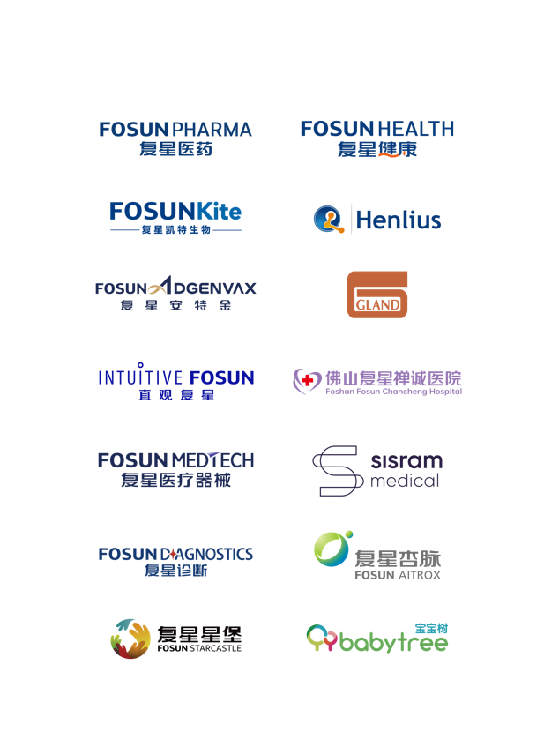
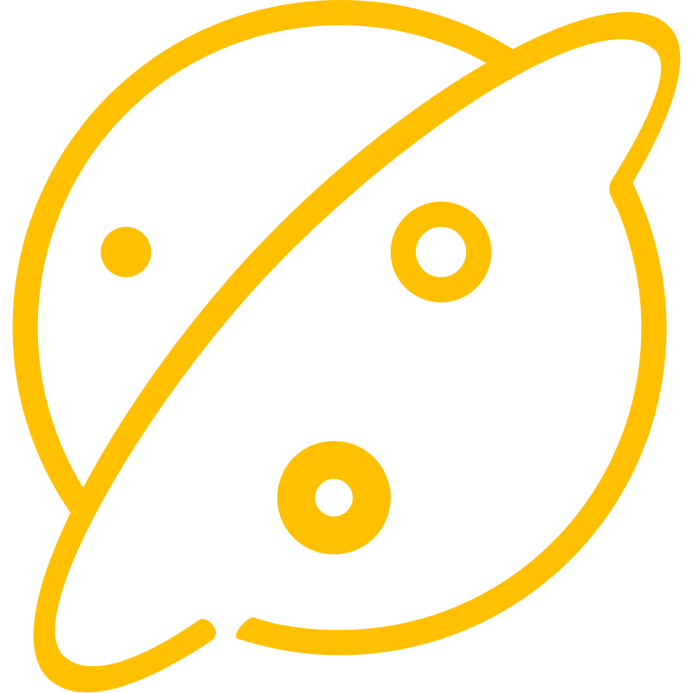
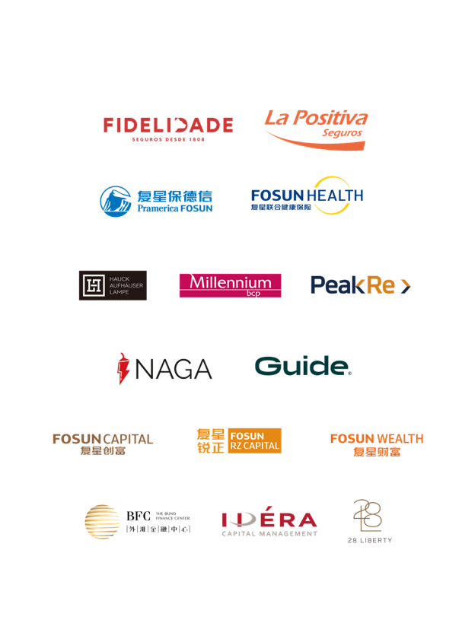



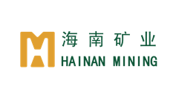

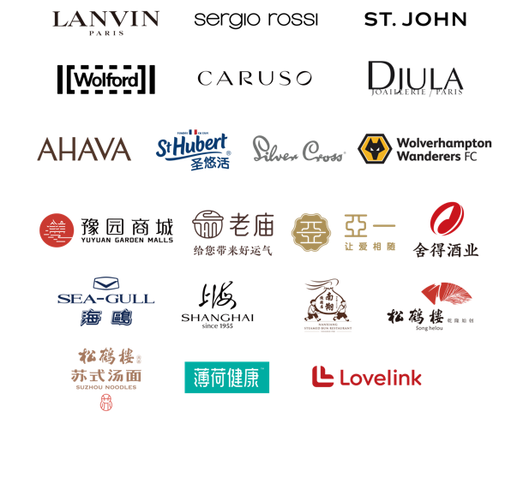


FOSUN FAMILY CONSUMPTION ECOSYSTEM
EVERY STAGE OF LIFE
INTELLIGENT MANUFACTURING
HEALTH
HAPPINESS
WEALTH

Slide 7
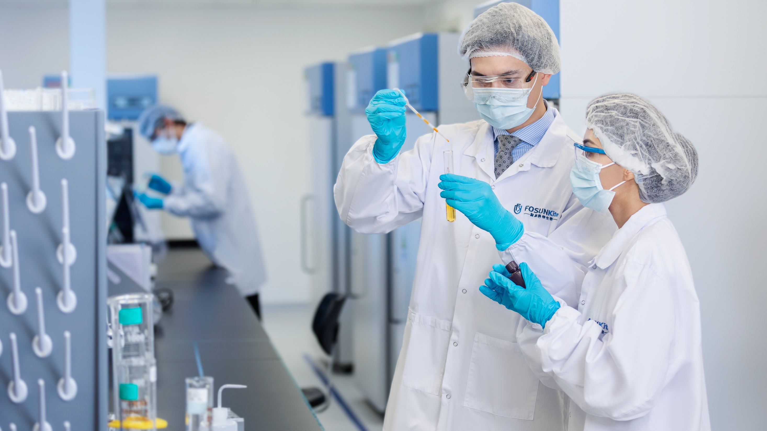


HEALTH
Transform the industry with technology
to create healthier lives

Slide 8


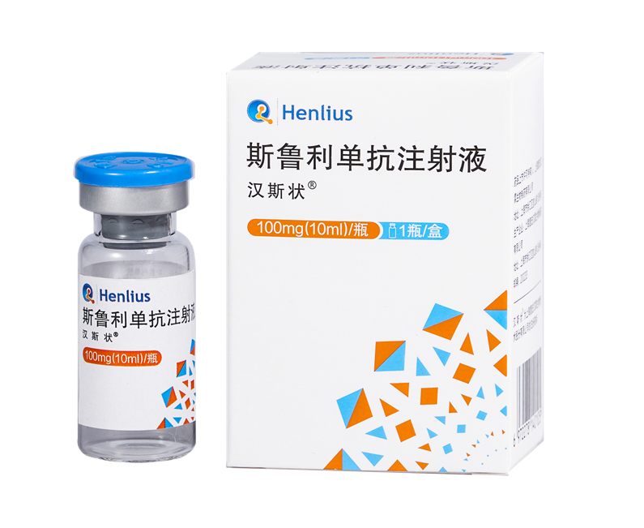





PHARMACEUTICALS
Fosun Pharma continues to increase investment in innovation and R&D to promote innovative transformation, and focuses on the three major business divisions of innovative medicines business, established medicines manufacturing and supply business, and vaccines business
RMB5.89 billion
Fosun Pharma’s R&D investment in 2022
Over 260
Pipeline projects on innovation drugs, biosimilars, generic drugs, and consistency evaluation items as of the end of 2022
HANSIZHUANG (Serplulimab Injection)
The first self-developed biopharmaceutical innovative drug
The world's first monoclonal antibody drug targeting PD-1 for first-line treatment of extensive-stage small cell lung cancer
Approved for three indications in Chinese Mainland
HANQUYOU (Trastuzumab Injection)
The first monoclonal antibody biosimilar approved in China and Europe
The BLA for breast cancer and metastatic gastric cancer indications was accepted by the United States Food and Drug Administration (FDA)
The China-developed biosimilar with the most marketing approvals, covering more than 40 countries and regions with a cumulative global shipment volume totaling over 3 million units
Yi Kai Da (Axicabtagene Ciloleucel Injection)
The first CAR-T cell therapy product approved for marketing in China
Second-line indication approved in Chinese Mainland
Benefited more than 500 patients in China since its launch
Artesunate for injection
The first generation, Artesun®: recommended by the World Health Organization (WHO) as the first choice for the treatment of severe malaria, which has treated more than 56 million severe malaria patients worldwide
The second generation, Argesun®: the world’s first artesunate injectable presented with a single solvent system that received WHO Prequalification (WHO PQ) and has already been registered in 16 countries

Slide 9
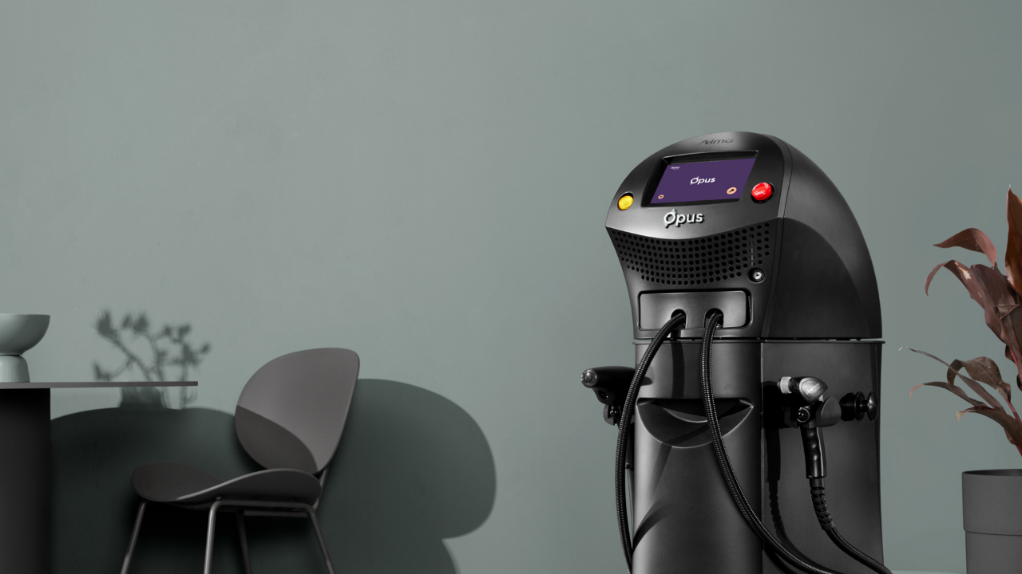
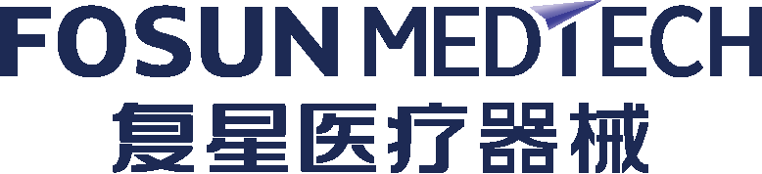

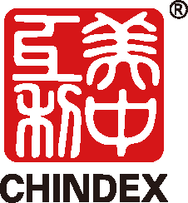

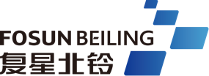


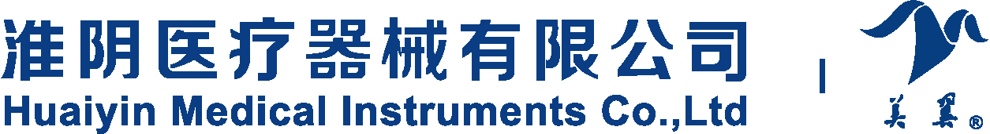
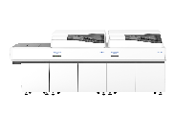
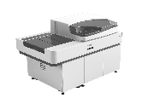

DEVICES & DIAGNOSIS
Focusing on the operation of the medical device industry, Fosun Medtech is committed to becoming an industrial technology platform providing comprehensive digital and intelligent solutions.
Focusing on the in vitro diagnostics industry , Fosun Diagnostics is committed to becoming the world's leading technological innovator in medical diagnostic solutions
More than 330
Da Vinci Surgical Systems installed in Chinese mainland, Hong Kong SAR and Macau SAR as of 30 June 2023
Domestic da Vinci Xi surgical system
The “thoracic and abdominal endoscopy surgical control system” was approved by the National Medical Products Administration (NMPA)
Introduced various devices to new markets
Soprano Titanium™ was introduced to the North American market following regulatory FDA clearance
Alma Opus was introduced to international markets outside the United States, including the Chinese market
Vivo45, Vivo1-2 andVivo3 ventilators entered the Chinese market, new technologies keeping pace with the world
Based on independent R&D and innovation-driven development, Fosun Diagnostics' R&D investment has increased year by year, from 7.6% in 2021 to 19.3% in 2023.
It has developed a variety of products for clinical chemistry, immunoassays, molecular diagnosis, microbiology and POCT, etc. and has built a large automatic pipeline and a small POCT product group focusing on six major diseases including tumors, digestive and metabolic diseases, cardiovascular and cerebrovascular diseases, reproductive disease, central nervous system diseases and infections.
In May 2023, Fosun Diagnostics launched the sophisticated, comprehensive, intelligent, agile F-A7000 Series assembly line system.

Slide 10
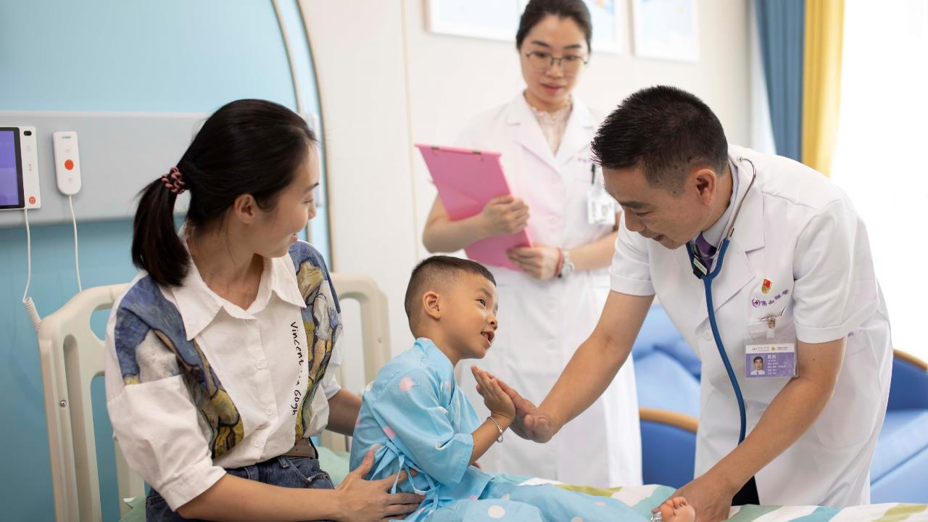




HEALTHCARE SERVICES
Based on its advantageous medical resources and digital platform, Fosun provides users with closed-loop solutions throughout the treatment course and one-stop health management services that combines healthcare, medicines, health and insurance
6448 beds ¹
In member hospitals
Operational excellence
Foshan Fosun Chancheng Hospital became the first medical institution in Foshan designated by the measure of using Hong Kong registered drugs and medical devices used in Hong Kong public hospitals in Guangdong-Hong Kong-Macao Greater Bay Area
StarKids Children’s Hospital Shanghai formally commenced its business, and deeply engaged in the gynecology and pediatrics sector
Chongqing Xingrong Plastic Surgery Hospital became the first dual-base for drug and medical device clinical trials in China registered as a socially-organized medical institution
Digital intelligence construction
Several Fosun healthcare institutions launched “Cloud HIS” (a new generation of smart medical cloud platform) and the internet hospital SaaS
Insurance empowerment
Promotes the establishment of the commercial insurance system for its member medical institutions and creates customized innovative insurance payment solutions, allowing more patients with specialized needs to enjoy specialized medical services
¹ It refers to the number of beds in member hospitals as of the end of June 2023

Slide 11
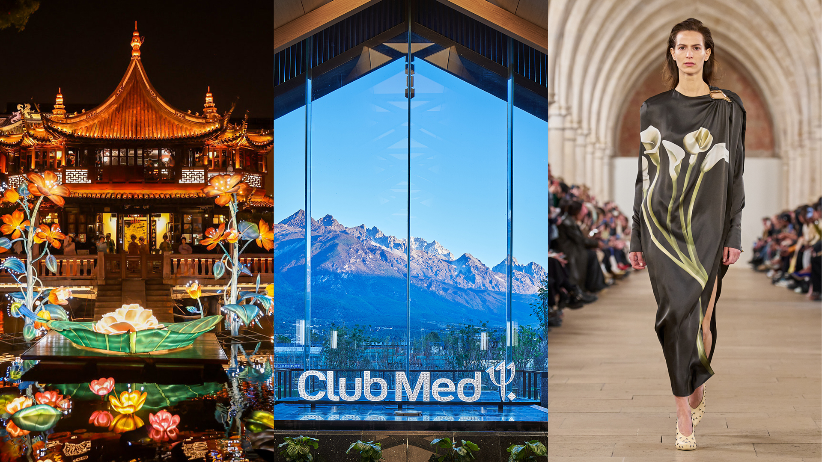

HAPPINESS
Focus on family customers, develop contents, models and products for families
to link online platforms and offline scenarios

Slide 12
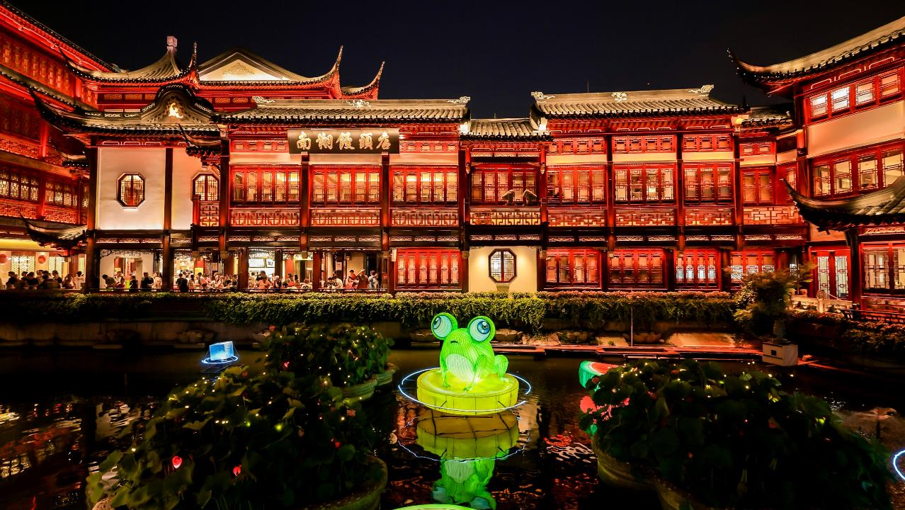
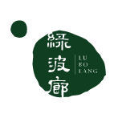
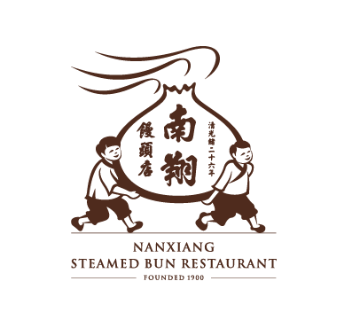
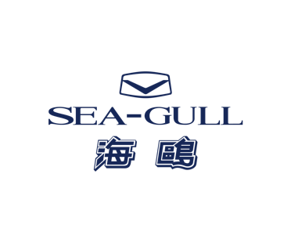
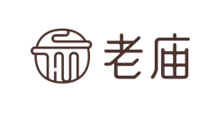
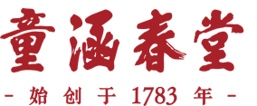
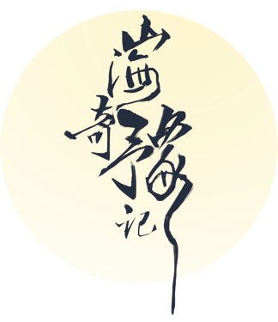


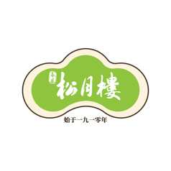
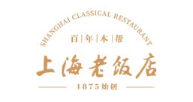

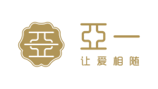
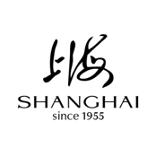


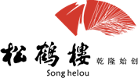
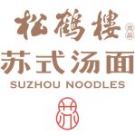

YUYUAN
As one of the flagship platforms of Fosun‘s Happiness segment, Yuyuan takes oriental aesthetics as the key strategy to promote Chinese culture to the world,
creating happier lives for families worldwide
YUYUAN GARDEN
LANTERN FESTIVAL
JEWELRY AND FASHION
FOOD AND BEVERAGE
SPIRITS AND LIQUOR
CHINESE WATCHES
BEAUTY AND HEALTH
Inspired by Shanhaijing, also known as "the Classic of Mountains and Seas", the lantern festival attracted more than 4 million visitors
The 29th Yuyuan Garden Lantern Festival made its overseas debut, with the event taking place in both Paris, France and Shanghai, China
Store expansion continued to accelerate, with the number of stores reaching 4917
Sales of Laomiao’s Guyun Gold series exceeded RMB5.0 billion in the first half of 2023
Accelerated chain development of catering brands
Songhelou Suzhou-style Noodle Shop has more than 180 shops in China
Shede Spirits adheres to the "aged spirits strategy", the “multi-brand matrix strategy”, the “brand rejuvenation strategy” and the “internationalization strategy”
Exported to 25 countries and regions
Two Chinese watchmakers,
and one Chinese chip
Tong Han Chun Tang, a time-honored brand with 240 years of history carrying on the classics
Bring brands to the global stage to reshape their future

Slide 13

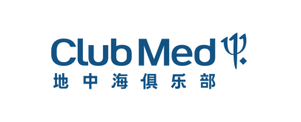

FOSUN TOURISM GROUP
As a flagship platform of the Happiness segment, Fosun Tourism Group (FTG) is a world-leading leisure-focused integrated tourism group, and is striving to create a new concept of “Better Holiday, Better Life”, infusing evolving concepts of tourism and leisure into everyday living
A world-renowned premium all-inclusive vacation service provider from France
A one-stop marine-themed integrated resort destination
Operating nearly 70 resorts on six continents around the world
By 2025, together with new opening and renovation, the annual capacity is expected to increase by 20% or more compared to that of 2022
Launched a new urban resort product line, Club Med Urban Oasis
A benchmark of Sanya Tourism 3.0
In the first half of 2023, Atlantis Sanya saw a full business recovery, with various performance indicators exceeding pre-pandemic levels and business volume reaching record high

Slide 14





LANVIN GROUP
A grand transformation. Lanvin Group has entered the new phase of global development
On 15 December 2022, Lanvin Group was listed on the New York Stock Exchange (NYSE) under the ticker symbol "LANV" and became China's first global luxury goods group listed on the NYSE. Revenue for the first half of 2023 was EUR215 million, up 6.4% yoy
The oldest operating French couture house
LANVIN
Italian luxury shoemaker Sergio Rossi
Austrian luxury skin wear brand Wolford
American luxury
womenswear brand
St. John
Italian high-end menswear brand
Caruso
Covering 80+
Approx. 1200
Approx. 300
countries and regions
points of sale
self-operated retail stores

Slide 15




MORE HAPPINESS
Focusing on sports, e-sports, film and television, games and other content to create a diversified entertainment experience of Fosun
Fosun Sports’ e-sports teams have won a total of
14 championships
in various competitions from 2022 to 2023
One of the founding members of the English Football League
Fosun Sports' Wolverhampton Wanderers Football Club. in the Premier League has won 11 league titles, 4 FA Cups and 2 League Cups
Lovelink strengthened its wedding planning business in 1st and 2nd-tier cities
The love community has expanded its overseas presence, and Beloved, an online interactive product for couples, has been launched in North America

Slide 16
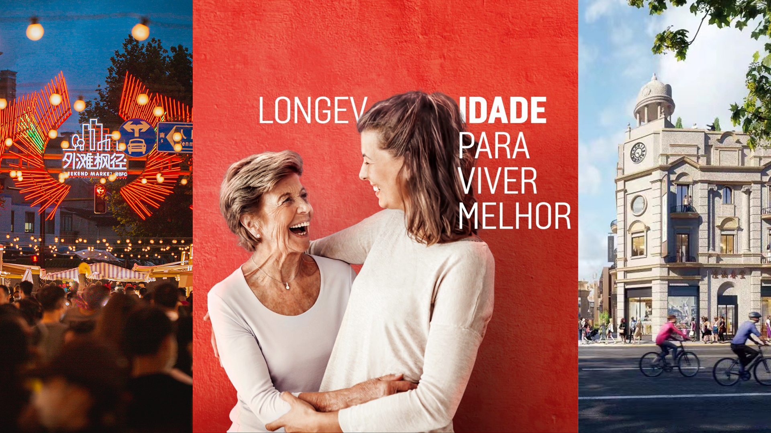

WEALTH
Insurance + financial resources and asset management capabilities empower each other
to create a closed-loop wealth ecosystem

Slide 17



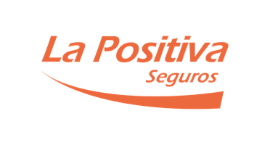


INSURANCE
Establish a global presence and adhere to innovative development and insurance ecosystem development
RMB30.2 billion
Premium
RMB167.5 billion
Investable assets
30.1%
Fosun Insurance Portugal’s market share in Portugal
EUR830 million
Premium from Fosun Insurance Portugal’s international business, up 19.4% yoy
Achieved substantial business growth in Latin America

Slide 18
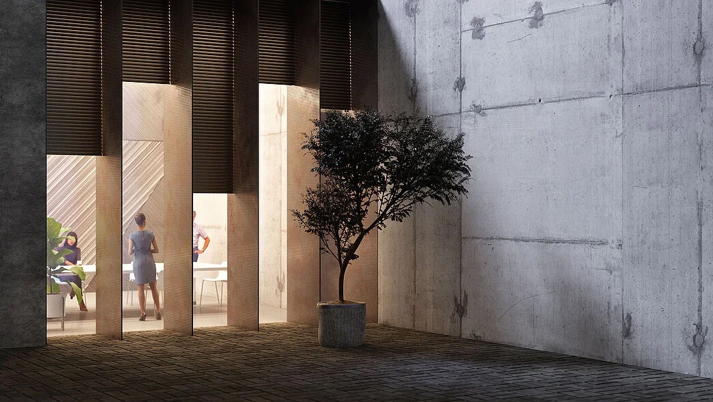


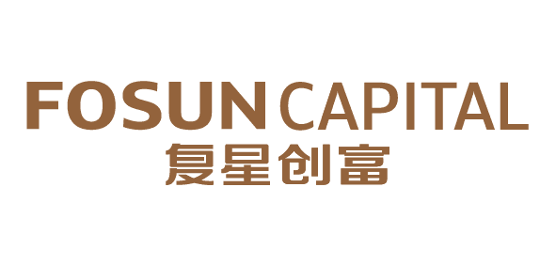
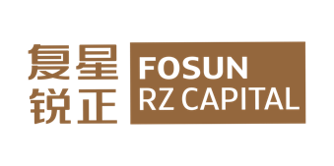



INVESTMENT MANAGEMENT
Industrial investment + financial investment as twin-driver to empower Health, Happiness, Wealth, and Intelligent Manufacturing in every stage of life
EUR266.0 billion
Assets under HAL’s service and management
+11%
Growth in assets under HAL’s service and management
HAL is ranked among the top three private banks in Germany, with a focus on managing, maintaining, servicing and trading client assets
EUR1199.9 million
BCP’s consolidated core operating profit for the first half of 2023
+40.1%
BCP’s consolidated yoy core operating profit growth for the first half of 2023
Millennium bcp, the largest privately-owned private bank in Portugal, provides commercial banking products and services to individuals and corporations, complemented by investment banking and private banking segments. It also owns ActivoBank, a leading digital bank
China's Top 10 Private Equity Firms in 2022
China's Top 7 Chinese Private Equity Firms in 2022
Fosun Capital
China’s Top 10 Corporate Venture Capitals (CVCs) in 2022
Top 30 Venture Capital and Private Equity firms in 2022
Fosun RZ Capital

Slide 19

HIVE
Introduce industries to cities to facilitate urban development, creating a global urban hive benchmark
TRAVEL & LEISURE HIVE
HEALTHCARE HIVE
INNOVATION HIVE
FINANCIAL SERVICE HIVE
CULTURE & ENTERTAINMENT HIVE
THE GRAND YUYUAN
40+
130+
A global fashion and cultural showground showcasing the charm of oriental lifestyle aesthetics
Cities
Projects
Fosun Hive, as an advocate and practitioner of the advanced outlook on sustainable development of the industry, focuses on the needs for industrial upgrading in urban development and relies on Fosun's global industrial resources to provide diversified, multi-form and multi-level customized industrial development solutions underpinned by industrial way of thinking. In the implementation of the city-industry integration strategy, Fosun Hives takes "industry operations" and "industrial investment" as the twin-driver to fully leverage the advantages of industry funds, promote the consolidated growth of industries, empower industrial transformation and upgrading, and build asset-light operating capabilities for the entire industry chain, thereby achieving rapid upgrading of urban functions and industrial levels.
The Grand Yuyuan includes Phase I and Phase II of Yuyuan, the land plot on Fuyou Road, and the Grand Yuyuan of the Bund Finance Center, providing an excellent space to showcase oriental lifestyle aesthetics. In the future, through the promotion of traditional culture, industrial transformation and upgrading, and the organic integration of modern residential functions, the Grand Yuyuan will be built into a gathering place for oriental lifestyle aesthetics, facilitating the construction of Shanghai's international fashion capital and comprehensively enhancing the soft power of Shanghai.

Slide 20
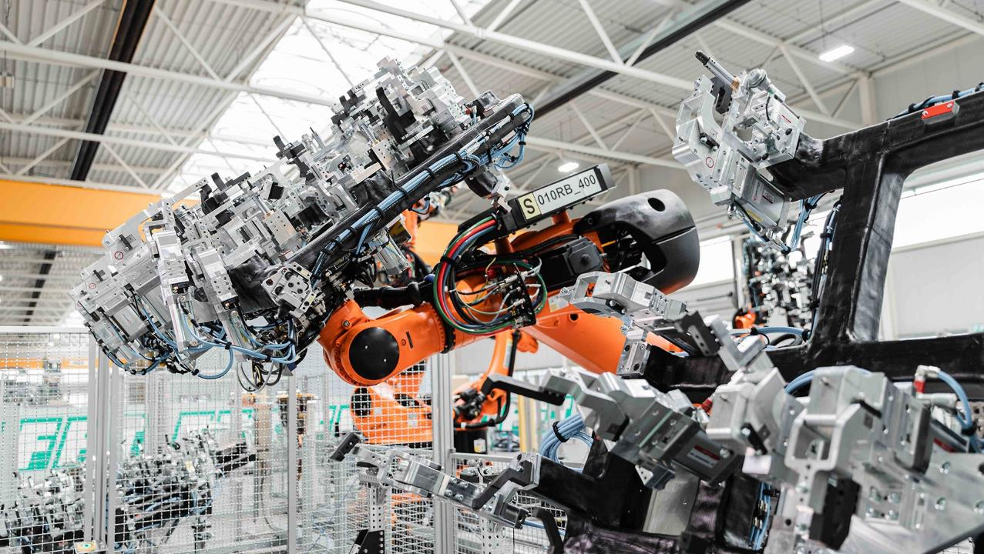

INTELLIGENT
MANUFACTURING
Develop digital intelligent technology globally
to empower industrial manufacturing

Slide 21
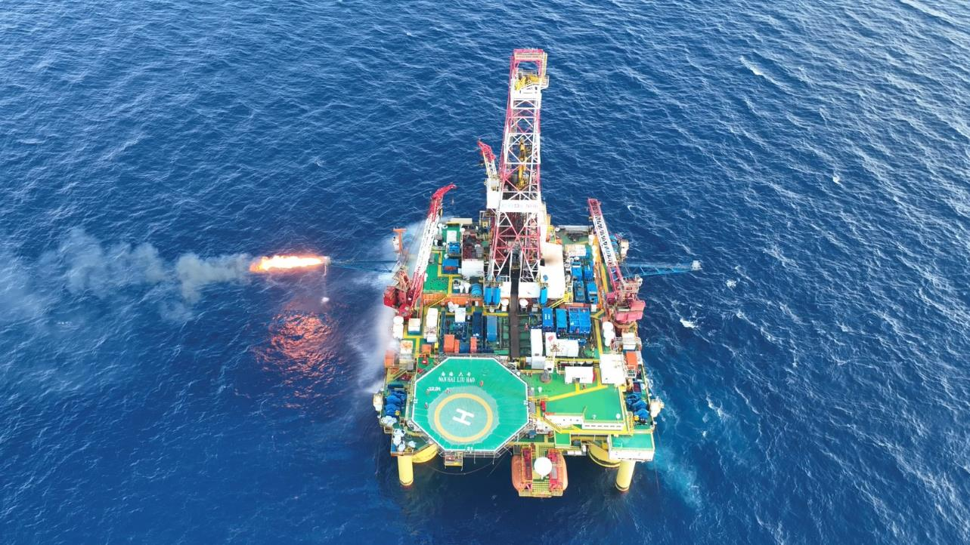






INDUSTRIAL LANDSCAPE
INTELLIGENT MANUFACTURING INDUSTRY
GREEN RESOURCE INDUSTRY
INDUSTRIAL DIGITALIZATION AND AUTOMATION
VEHICLE ELECTRIFICATION AND INTELLIGENCE
GREEN & LOW CARBON RESOURCES
FUNCTIONAL NEW MATERIALS
Achieve breakthroughs in core technology of advanced materials to upgrade the service manufacturing industry
A leader in intelligent manufacturing systems, facilitating the intelligent transformation of the manufacturing industry
Grasp strategic opportunities in the mobility industry to create an integrated solution for intelligent mobility
Leverage the mining business, oil and gas resources
to establish a presence in the green and low carbon industry
EMPOWERING UPGRADE, INTELLIGENCE, AND GREEN TRANSFORMATION OF THE M-END
20000 tons
The battery-grade lithium hydroxide project invested by Hainan Mining is expected to be put into operation in the first half of 2024
Bougouni lithium mine
The project delivery of the Bougouni lithium mine in Mali, Africa, acquired by Hainan Mining has been accelerated
First set was launched in China
Easun Technology has developed software and hardware solutions that enabled the precise and intelligent matching of a vehicle body to break the monopoly of the market
Recognized as a “specialized, sophisticated, distinctive, and innovative” enterprise
Easun Technology and its subsidiaries were recognized as the second batch of "specialized, sophisticated, distinctive, and innovative” enterprise in Shanghai and the fifth batch of national specialized, sophisticated, distinctive, and innovative "little giant", respectively
Robust growth in North America
Easun Technology recorded a significant increase in its overseas high-margin orders and saw robust growth in business operations in North America

Slide 22


FOCUSED STRATEGY TO EMPOWER THE SUSTAINABLE GROWTH:
FOUR CORE COMPETENCIES TO DRIVE CORPORATE GROWTH
PROFOUND GLOBAL OPERATIONS
INNOVATION-DRIVEN
The model of “global organization + local operations” has matured
Global development of core industries
Leverage global resources to serve customers worldwide
Driven by product innovation
Driven by digital intelligence innovation
Driven by management innovation
FC2M¹ ECOSYSTEM
FES SYSTEM
Fosun Entrepreneurship / Ecosystem System
Provide systematic methodology, tools and processes to realize
Fosun’s globalization, technological innovation and ecosystem operations
Improve operational capabilities to create a sustainable operational system
Improve C2M capabilities and create species
Link species, form ecosystem, and achieve multiplier growth
Enhance industrial capabilities through comprehensive digital intelligence to connect all ecosystems
¹ FC2M: “F” represents Fosun and family, and C2M represents Client to Maker

Slide 23
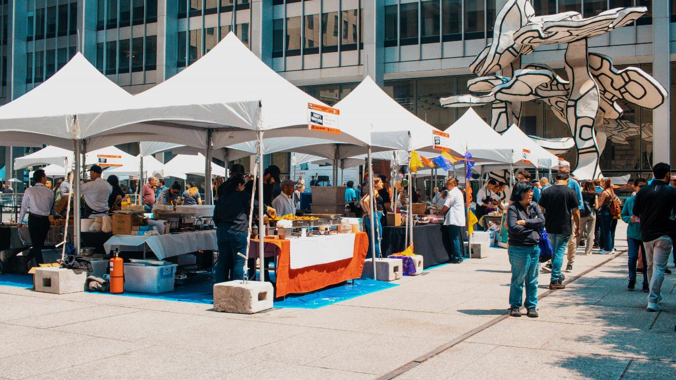





PROFOUND GLOBAL OPERATIONS
FRANCE
Club Med
LANVIN
TRIDEM
PAREF
DJULA
St Hubert
UNITED KINGDOM
Wolverhampton Wanderers Football Club
Resolution Property
Silver Cross
GERMANY
HAL
FFT
NAGA
Tom Tailor
ISRAEL
Sisram Med
AHAVA
AUSTRIA
Wolford
JAPAN
IDERA
Tomamu
The Court
MIRAI
CHINA
Fosun Pharma
Fosun Kite
Shanghai Henlius
Sinopharm Group
Fosun Aitrox
Fosun Health
Foshan Fosun Chancheng Hospital
Yuyuan
Yuyuan Tourist Mart
Laomiao
Shede Spirits
Shanghai Hanchen Watch
Tong Han Chun Tang
Fosun Tourism Group
Atlantis Sanya
Lanvin Group
Pramerica Fosun Life Insurance
Peak Re
Fosun Capital
Fosun RZ Capital
Fosun Wealth
The Bund Finance Center
Hainan Mining
Easun Technology
JEVE
Fusionride
Wansheng
UNITED STATES
28 Liberty
Fourtrees
Everest
St. John
WEI Beauty
GLOBAL
PRESENCE
GLOBAL
BUSINESSES
GLOBAL
INNOVATION
GLOBAL
TALENT
Established profound industry operations in nearly 35 countries and regions across five continents in the world
More than 40% the revenue comes from overseas countries and regions outside China
Focus on the Americas, Africa, India and Europe to build differentiated regional and global capabilities
1More than 20 overseas partners among over 150 global partners
PERU
La Positiva
ITALY
The Medelan
Sergio Rossi
Caruso
BRAZIL
Rio Bravo
Guide
SINGAPORE
Fosun Hive Capital Management
PORTUGAL
Fidelidade
BCP
Luz Saúde
Fosun Hive Iberia
INDIA
Gland Pharma
AUSTRALIA
ROC

Slide 24

PROFOUND GLOBAL OPERATIONS
2010-Beginning: Global Operations 1.0
Combining China’s growth momentum with global resources
2017-Deepening: Global Operations 2.0
Mutual empowerment between China and the world
2022-Evolution: Global Operations 3.0
Global organization + local operations
45%
Sales revenue from overseas
countries and regions
35+
Countries and regions with
revenue exceeding 100 million
39
Overseas brands & enterprises
30+
Overseas global partners
44000+
Overseas employees
Cross-cultural and cross-organizational capability
Digital intelligence capability
FES global management and operation system
Global innovation capability
Global investment capability

Slide 25






INNOVATION-DRIVEN
The two stories of Fosun with the Nobel Prize
HANSIZHUANG (serplulimab injection)
The first self-developed biopharmaceutical innovative drug
The world's first monoclonal antibody drug targeting PD-1 for first-line treatment of extensive-stage small cell lung cancer
Approved for three indications in Chinese Mainland
Artesunate for injection independently developed by Fosun Pharma; had supplied over 300 million vials of the artesunate for injection, treating more than 56 million severe malaria patients worldwide. Tu Youyou, a renowned Chinese scientist and Nobel laureate in Physiology or Medicine in 2015, for the discovery of artemisinin.
Participate in the R&D of mRNA COVID-19 vaccine, Comirnaty: More than 40 million doses had been administered in Hong Kong, Macau and Taiwan region, building a health protection barrier. The mRNA vaccines technology awarded the 2023 Nobel Prize in Physiology or Medicine.
HANQUYOU (trastuzumab injection)
The first monoclonal antibody biosimilar approved in China and Europe
The BLA for breast cancer and metastatic gastric cancer indications was accepted by the FDA
China-developed biosimilar with the most marketing approvals, covering more than 40 countries & regions
R&D investment in 2022
10.4
10+
YI KAI DA (ejilunsai injection)
billion ¹
The first CAR-T cell therapy product approved for marketing in Chinese Mainland
Second-line indication approved in Chinese Mainland
to strengthen technology innovation capabilities
Global technology innovation centers
LEADING
CORE TECHNOLOGIES IN VARIOUS FIELDS
INNOVATIVE
TECHNOLOGY INNOVATION CENTERS IN VARIOUS FIELDS
Artesunate for injection
The first generation, Artesun®: recommended by the WHO as the first choice for the treatment of severe malaria, which has treated more than 56 million severe malaria patients worldwide
The second generation, Argesun®: the world’s first artesunate injectable presented with a single solvent system that received WHO PQ
Innovative drug: focus on core therapeutic areas such as oncology, immunology, central nervous system, and chronic disease, and mainly strengthen core technology platforms such as small molecule, antibody/ADC, cell therapy, and RNA
Vaccine: platforms of bacterial vaccine + viral vaccine
Device: three major platforms of medical cosmetology + respiratory health + professional medical care
Research and application of oriental lifestyle aesthetics
Construction of the 4D technology innovation system: five senses of consumers + technology innovation R&D + creative design + technology innovation digitalization
Insurance: digital platform optimizes customer experience throughout the life cycle
Intelligent travel: full-stack self-developed L2+ intelligent driving software and hardware solutions
Industrial automation: leveraging digital twin, machine vision and other technologies accumulated for many years in the industry, AIGC large models are introduced to promote the industry's fully intelligence and automation
New energy: from traditional energy to the upstream extension of new energy and new materials
Fosun Pharma Global R&D Center (national level)
JEVE Technology Center (national level)
Wanbang Biopharma Quality Department QC Lab
Fosun Cosmetics Global Innovation Center(CNAS certified)
Fosun Pharma North America R&D Headquarters
Shanghai Key Laboratory of Stem Cell Therapy
Sichuan Engineering Technology Center for Intelligent Brewing of Baiju
Lanvin Group Fabric Innovation Center
Yuyuan Jewelry Creative House
Yuyuan Foods & Dining Group Innovation Center
Academician Enterprise Research Institute
Fosun Wine & Spirits Group Innovation Center
…
Domestic da Vinci Xi surgical system
The “thoracic and abdominal endoscopy surgical control system” was approved by NMPA
Easun Technology
Easun Technology has developed software and hardware solutions that enabled the precise and intelligent matching of a vehicle body to break the monopoly of the market. The first set was launched in China
Fosun Cosmetics Innovation Center
Received the Laboratory Accreditation Certificate issued by the China National Accreditation Service for Conformity Assessment (CNAS)
Fosun Wine & Spirits Group Innovation Center
Officially put into operation
¹ It includes scientific research investment (expensed and capitalized), but does not include digital investment

Slide 26

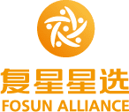


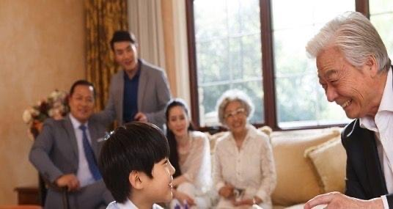
FC2M ECOSYSTEM
Membership platform of Fosun ecosystem
Medical-grade, all-scenario,
one-stop health ecosystem
SCENARIOS
PLATFORMS
INDUSTRIES
21.65 million
6.2 billion (RMB)
52.8%
60
32%
Number of newly registered members¹ in the first half of 2023
Total value created by the Group’s ecosystem ²
Sales revenue contributed by members in the first half of 2023
Domestic and foreign brands collaborated during 515 Fosun Family Day
Yoy sales growth of 515 Fosun Family Day
F
C2M
FOSUN/FAMILY
CLIENTS
LINK
PRODUCTS & SERVICES
¹ It refers to those who have agreed to the official membership terms of the brand and granted privacy in any channels, and actively retained personal information including mobile phone number, to meet the needs of identifiable, reachable and traceable consumers
² It refers to the revenue contribution (before intercompany eliminations) directly or indirectly created by companies within the Fosun ecosystem for other companies with the ecosystem including but not limited to cross-selling, product co-creation, membership contribution, membership sales transformation, and sales collaboration within the ecosystem, joint industrial investment, financing cooperation empowerment, industrial resource coordination, etc.

Slide 27
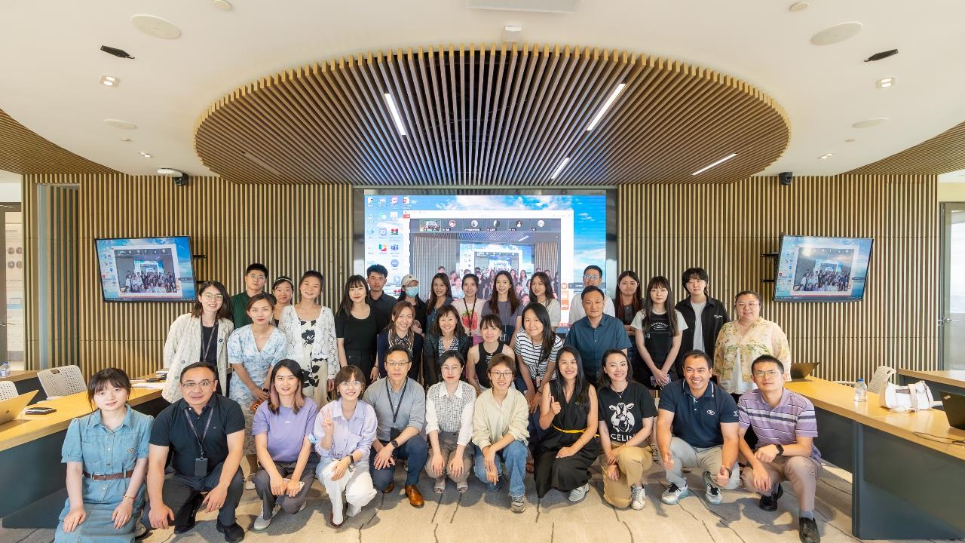
FES SYSTEM
FES
The FES system is a continuously evolving management system that helps Fosun build core competitiveness of a long-standing enterprise and nurture talent with Fosun’s entrepreneurship. The system provides Fosun with systematic methodology, tools and processes to realize Fosun’s global operational capabilities, technology innovation and smooth operation of Fosun ecosystem. With the joint efforts of all employees, Fosun has established a corporate culture of continuous improvement and growth, contributing the “power of Fosun” to the development of the whole society
（Fosun Entrepreneurship / Ecosystem System）
PROFOUND
INDUSTRIAL
DEVELOPMENT
Ecosystem | Synergy
ENTREPRENEURSHIP
ECOSYSTEM
MULTIPLIER GROWTH
LEAN
OPERATIONS
PROFIT
CASH FLOW
FIVE
MODULES
VALUE
GROWTH
RISK
MANAGEMENT
Accumulation
FES
Practice
45
Certified tools
Nearly 800 expert certifications annually
BUSINESS
OPERATIONS
Management | Process
INVESTMENT
AND M&A
Strategy | Sectors
1000+
Corporate improvement projects every year
260+
FES best practice cases
GROWTH
PROFOUND INDUSTRY OPERATIONS + INDUSTRIAL INVESTMENT

Slide 28
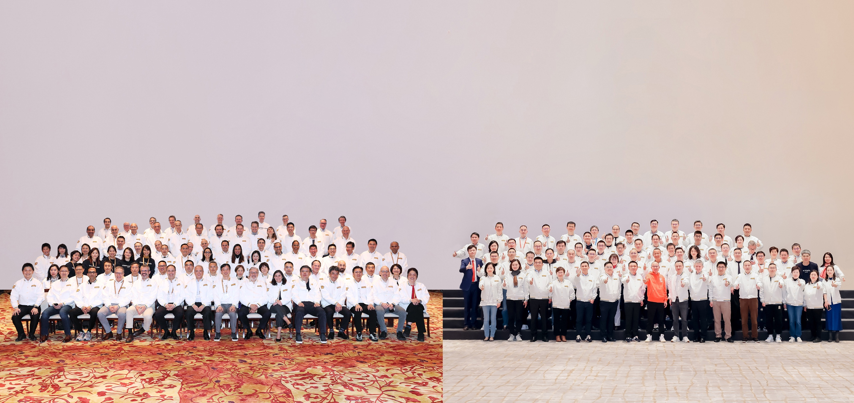

TALENT, THE MOST VALUABLE ASSET OF FOSUN
A ROBUST TEAM OF TALENT DETERMINES THE SCALABILITY OF THE COMPANY’S FUTURE DEVELOPMENT
ELITE MANAGEMENT TEAM
GLOCAL
TALENT DEVELOPMENT STRATEGY
150+ global partners, 280+ industry partners,
400+ functional line partners, 70+ innovation partners,
with regular rotation to deeply involve in each project, field, and region
30+ overseas global partners coming from countries including Portugal, France, Germany, the United Kingdom, Japan, India, and the United States
Attract talent with development, appraise talent based on performance, train talent through work, and unite talent with career opportunities

Slide 29
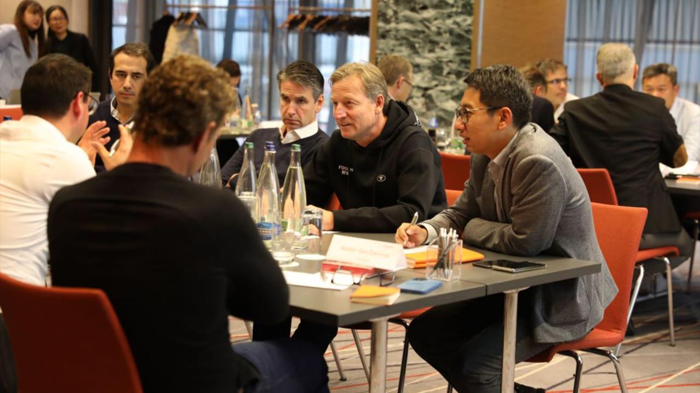





FOCUS ON KEY TALENT TO BUILD A TEAM WITH ENTREPRENEURIAL SPIRIT
Consolidate the multi-level partner mechanism to form an elite partner echelon and lead key talent to manage the system
FOSUN PARTNERS
MID-LEVEL ENTREPRENEURS
FUTURE ENTREPRENEURS
TECHNOLOGY INNOVATION TALENT
300 +
Future Fosun global partners
3000 +
Future entrepreneur backups
30%
High-potential talent
100 +
Top scientists of Fosun ecosystem
FUTURE FOSUN GLOBAL PARTNER BACKUPS
Build a “pyramid-shaped” partner backup array,
forming a competitive dynamic partnership management mechanism that allows talent appraisals at different levels according to their performance

Slide 30

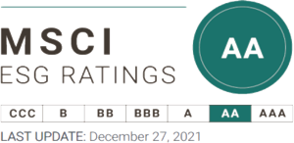

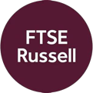



REMARKABLE ESG ACHIEVEMENTS FOR A BRIGHTER LIFE
AA-
The only conglomerate in Greater China with an MSCI ESG rating of AA
Selected as a constituent of the MSCI CHINA ESG LEADERS 10-40 Index
Its member company, Fosun Tourism Group’s MSCI ESG rating jumped to AAA
In August 2023, Fosun International was selected a constituent of Hang Seng Corporate Sustainability Index, which includes the top 30 Hong Kong listed companies that perform best in ESG
Selected as a constituent of the Hang Seng ESG 50 Index
Selected as a constituent stock of the Hang Seng Corporate Sustainability Benchmark Index (HSSUSB)
Fosun International’s S&P Global Corporate Sustainability Assessment (CSA) score was higher than 91% of its peers around the world and significantly ahead of the industry average score
Fosun International and Fosun Tourism Group were included in S&P Global’s Sustainability Yearbook 2023 (China Edition) and recognized as an “Industry Mover” by S&P Global
Selected as a constituent of FTSE4Good Index Series
ESG RATINGS HAVE CONTINUED TO IMPROVE IN 2023
E
S
G
CARBON NEUTRALITY STRATEGY
FOSUN FOR GOOD
CORPORATE GOVERNANCE
Achieve carbon neutrality goal by 2050
EHS management framework
Climate risk response
Rural Doctors Program
Assist WHO in building a malaria-free world
Serve the national rural revitalization strategy
Help achieve common prosperity and the United Nations SDGs
Employee care
Continue to optimize and evolve corporate risk management
Improve ESG governance structure with the ESG Executive Committee and ESG Management Committee
Actively communicate with external investors and rating agencies on ESG issues

Slide 31
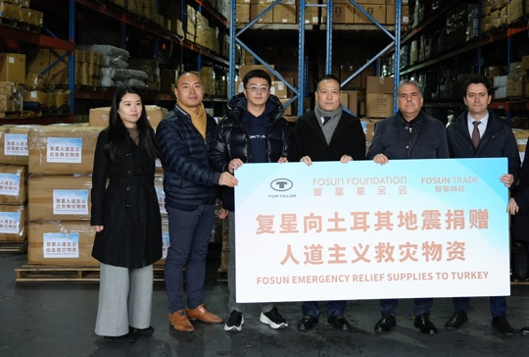
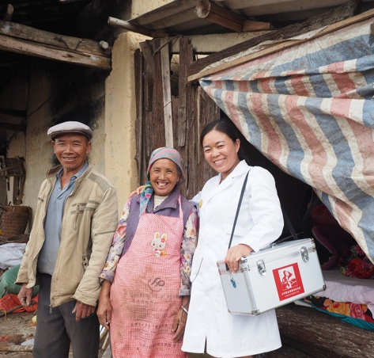




FOSUN FOR GOOD
RURAL DOCTORS PROGRAM
A HEALTHY WINTER ACTION
As of September 2023, the program has covered 78 counties in 16 provinces, municipalities, and autonomous regions, sent a total of 366 staff to assist the counties, served approx. 24000 rural doctors and benefited 3 million grassroots families
EMERGENCY
RELIEF
In January 2023, “A Healthy Winter Action” was launched to donate RMB100 million worth of Azvudine Tablets to rural areas in central and western China, nursing homes and welfare homes. “A Healthy Winter Action” has donated a total of more than 284800 bottles of Azvudine tablets and RMB5.125 million worth of care packages, covering in 250 municipalities and counties in Anhui, Yunnan, Guizhou, Henan, Gansu, Xinjiang, Tibet, etc.
RURAL REVITALIZATION
EMERGING VISIONARIES
Over the past ten years, more than 6500 Chinese middle school students have applied the program, and two Charity Ambassadors selected each year are invited to represent China in the United States to receive awards and participate in global exchanges
HEALTH
TAI CHI ANTI-PARKINSON’S DISEASE,
TAI CHI FOR DELAYING ALZHEIMER’S DISEASE
EDUCATION
The scientific research findings of Tai Chi as an adjuvant therapy for chronic diseases were published in international authoritative journals
Organized 3144 hours of offline charitable Tai Chi classes to 445 patients with Parkinson’s disease from 2015 to the end of 2022
Organized d 945.5 hours of online charitable Tai Chi classes from 2020 to the end of 2022, which benefited 23491 people
PROTECHTING
GLOBAL YOUTH START-UP ACCELERATION PROGRAM
ARTS & CULTURE
Received 896 applications from 40+ countries and regions since 2016; won 3 international awards in recognition of its corporate social responsibility; 33 closely cooperated start-up projects and 5 companies signed commercial contracts
The Fosun Foundation was established in November 2012 as the main humanitarian arm of the Fosun Group and is a “5A Social Organization”. Adhering to Fosun‘s values of “Self-improvement, Teamwork, Performance and Contribution to Society”, Fosun Foundation insists on serving the society, the people and the nation. The coverage of the foundation includes disaster relief, healthcare, poverty alleviation, rural revitalization, education, community building, youth entrepreneurship and culture, art, etc., serving many countries and regions around the world
FOSUN FOUNDATION (SHANGHAI)
ASSIST AFRICA IN FIGHTING AGAINST MALARIA
Fosun Foundation (Shanghai) is a non-profit organization launched and supported by the Fosun Group and Fosun Foundation. Its programs are characterized by contemporary, international, and highly interactive artworks. It has held a total of 28 art exhibitions and has attracted more than 1.75 million visitors since 2016
Fosun Pharma supplied over 280 million vials of artesunate for injection to the international market, which benefited over 56 million patients with severe malaria

Slide 32






RURAL DOCTORS PROGRAM
Delivering hope to impoverished people in rural areas
The Rural Doctors Program is one of the key initiatives to realize the goal of common prosperity. In late 2017, under the guidance of the National Health Commission Poverty Relief Office, Fosun Foundation, together with China Population Welfare Foundation, etc., initiated the Rural Doctors Poverty Alleviation Program (“Rural Doctors Program”) to empower millions of rural doctors who are working in the frontlines, thereby accelerating the realization of Healthy China
366
16
78 counties
On-site workers
Provinces, municipalities and autonomous regions covered across the country
Including 21 key national poverty-stricken counties
In September 2021, the Rural Doctors Program was awarded the "China Charity Award"
In December 2022, the Rural Doctors Program was awarded the “Shanghai Charity Award”
The micro-documentary, For Their Clear Sky won Best Film on "Rural Revitalization" in the short film category at the 13th Beijing International Film Festival
23956
3 million
Rural doctors served
Grassroots families benefited
纪录片海报
*Data as of September 2023

Slide 33


FIGHT AGAINST MALARIA IN AFRICA
Assisting in building a “malaria-free world”
280 million +
56 million +
The number of vials of artesunate for injection (60mg) that Fosun Pharma supplied to the global market since 2005, according to incomplete statistics
The number of patients with severe malaria that Artesun® (artesunate for
injection) has saved
175 million
Charitable activities to build a malaria-free world
The number of children in high malaria transmission African countries benefited
from SPAQ-CO® Disp, a malaria prevention drug for children which was prequalified by the WHO
Fosun collaborated with its member companies and eco-partners in more than 15 countries and regions in a campaign for a malaria-free world through a variety of charitable activities, helping mankind build a healthy and better future.
Second-generation artesunate for injection, Argesun®
In June 2023, Argesun®, the second-generation artesunate for injection self-developed by Fosun Pharma became the first artesunate injectable presented with a single solvent system that received the WHO PQ , which will further enhance the accessibility of innovative antimalarial drugs and save more lives
“We will join forces and work with anti-malaria experts as well as other parties to continue to carry out malaria education projects for the public and raise the public awareness of malaria prevention. We will also actively participate in public health improvement and make steady efforts to build a malaria-free world.”
Guo Guangchang

Slide 34




TAI CHI ANTI-PARKINSON’S DISEASE,
TAI CHI FOR DELAYING ALZHEIMER’S DISEASE
Slow therapy for chronic disease to hold on to the good memories
Fosun Foundation cooperated with the Neurology Department of Ruijin Hospital to jointly launch “Tai Chi Anti-Parkinson’s Disease” and “Tai Chi for Delaying Alzheimer’s Disease”
In 2018, the research article titled “Reduction of HIP2 expression causes motor function impairment and increased vulnerability to dopaminergic degeneration in Parkinson’s disease models” was published in Cell Death & Disease
TAI CHI ANTI-PARKINSON’S DISEASE
520
3144 hours
945.5 hours
23491
Offline
Online
Participants online
Patients with Parkinson’s
disease served since 2015
TAI CHI FOR DELAYING ALZHEIMER’S DISEASE
53
167.5 hours
In February 2022, the research article titled “Mechanisms of motor symptom improvement by long-term Tai Chi training in Parkinson’s disease patients” was published in Translational Neurodegeneration
Patients with Alzheimer’s disease served
Charitable Tai Chi classes organized (offline)
COMMUNITY TAI CHI VOLUNTEER INSTRUCTOR TRAINING
5
147
1764
88
Communities served
Elders served
Participants
Tai chi volunteers trained
* Data as of the end of December 2022
In March 2022, the research article titled “Tai Chi enhances cognitive training effects on delaying cognitive decline in mild cognitive impairment” was published in Alzheimer's & Dementia

Slide 35


FOSUN FOUNDATION (SHANGHAI)
Fosun Foundation (Shanghai) aims to promote contemporary art and is committed to binding Chinese and international art and culture, and promote public awareness, understanding and engagement in global contemporary art. Fosun Foundation (Shanghai) continues to support local Chinese artists, providing a broad display platform for outstanding Chinese contemporary art works. Fosun Foundation (Shanghai) is located in the Bund Finance Center. Fosun Foundation (Chengdu) was opened in June 2022. Fosun Foundation (Shanghai) participates in, witnesses and leads the development of contemporary art and culture. As an art consultant, Fosun Foundation (Shanghai) has long showcased its collection of Chinese art works in global landmark buildings such as Liberty 28 in New York to promote global cultural and artistic exchanges
The first 3A social
organization among
Shanghai contemporary art
institutions
28 art exhibitions
1.75 million+ visitors
Committed to presenting international and Chinese contemporary art exhibitions and special exhibitions with rich content, including “Tadao Ando: Endeavors”, “Yayoi Kusama: All About Love Speaks Forever”, etc.
550+ public education campaigns
45000+ participants in public education campaigns
The first governing unit of
Shanghai Art Museum
Association
Insist on organizing high-quality public education campaigns to help the public understand art and promote active participation in art-related events
400+ Fosun Foundation (Shanghai) Night and Aesthetic Journey
Organize diversified and comprehensive cross-brand activities to promote public awareness and public engagement in the latest contemporary art trends
Shanghai Municipal Administration of
Culture and Tourism's "Civilization
and Integrity, Art Appreciation" co-construction unit, Shanghai Public
Welfare Base, Donghua University
Aesthetic Education Practice Base

Slide 36



TOWARDS A BRIGHTER LIFE
HONG KONG |  | SHANGHAI
Room 808, ICBC Tower, 3 Garden Road, Central, Hong Kong |  | Bund Finance Center, No. 600, Zhongshan East 2nd Road, Huangpu District, Shanghai
Tel: | +852 2509 3228 | Tel: | +86 21 2315 6666
Fax: | +852 2509 9028 | Fax: | +86 21 6130 3288
 |  | Postal code: | 200010
A GLOBAL INNOVATION-DRIVEN CONSUMER GROUP
WeChat
Weibo
WeChat Channels

